Slide 1
Welcome to Homes for All!

Slide 2
Introductions
Name
Service Site
Year 1, 2, 3 ?
Dream vacation

Slide 3
Quick Getting To Know You
AmeriCorps Bingo

Slide 5
HOMES FOR ALL
Our primary focus is to address the affordable housing crisis through housing development, repair, and provision of housing and homeless services
AMERICORPS
AmeriCorps is a national service program that provides thousands of Americans with an opportunity to give back to their communities.
VISTA
VISTA (Volunteers in Service to America) is a national service program focused on social justice and economic equity.

Slide 6
AmeriCorps Values
GETTING THINGS DONE
through direct and demonstrable service
STRENGTHENING COMMUNITITES
bringing together people of all backgrounds to improve communities
ENCOURAGING RESPONSIBILITY
enabling members to explore and exercise their civic responsibilities
EXPANDING OPPORTUNITY
enhancing educational opportunities

Slide 7
The AmeriCorps Pledge
getting things done
I will get things done for America - to make our people safer, smarter, and healthier.
I will bring Americans together to strengthen our communities.
Faced with apathy, I will take action.
Faced with conflict, I will seek common ground.
Faced with adversity, I will persevere.
I will carry this commitment with me this year and beyond.
I am an AmeriCorps member, and I will get things done.

Slide 8
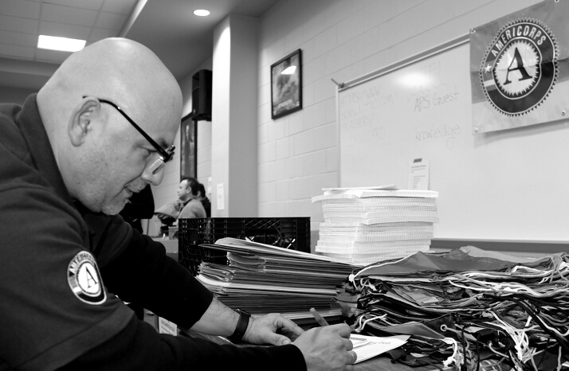
STATE/NATIONAL
VISTA
NCCC
direct service
capacity building
team based service projects
AmeriCorps Branches
Notes:
Largest branch of AmeriCorps
About 75,000 positions each year
Members serve with more than 15,000 locations
Positions in education, environment, health, housing, disaster response, and more
Sponsors include Habitat for Humanity, Teach for America, City Year, American Red Cross, Boys and Girls Clubs, and thousands of other nonprofits
Full-time and part-time positions
AmeriCorps’ poverty-fighting arm
Created in 1964 as part of War on Poverty
6,500 positions each year
VISTAs collaborate with low-income individuals and communities to fight poverty
Focus on capacity building: raising funds, recruiting volunteers, and designing sustainable programs
More than 1,200 project sponsors
Full-time year-long service
Team-based residential service
Focus on disaster response, environment, housing, and youth
Teams travel to projects in neighboring states
Open to 18-24 year-olds
1,100 positions each year
Members live on one of five campuses: Sacramento, CA; Denver, CO; Vinton, IA; Perry Point, MD; and Vicksburg, MS
Full-time 10-month service

Slide 9
AMERICORPS TERMS
MEMBER
SERVICE SITE
POSITION DESCRIPTION
LIVING ALLOWANCE
not employee
not worker
not volunteer
not job
not employment
not worksite
not job description
not salary
not wage
not stipend

Slide 10
Who Benefits From AmeriCorps?
we all do!
YOUTH, SENIORS, VULNERABLE POPULATIONS
COMMUNITIES AND ORGANIZATIONS
MEMBERS
people serving with AmeriCorps acquire leadership and career skills, earn money for college, and become civically minded.
communities are stronger and healthier when people are more engaged and more services are provided due to increased capacity.
benefit from tutoring, mentoring, health, housing, and other services.

Slide 11
National Service History & Roots
1965 – VISTA Program created
1973 – Beginnings of AmeriCorps Senior
1992 – NCCC is created to respond to disaster/critical needs
1993 – AmeriCorps, the agency, forms
1994 – First Class of AmeriCorps (20,000)
2012 – FEMA Corps to strengthen nation’s ability to respond to disasters
2016 – 1 million served

Slide 12
WHAT AmeriCorps DOES TODAY
EDUCATION
ENVIRONMENT
HOUSING
HEALTH
teach
tutor
mentor
conservation
disaster prep
disaster response
homelessness
build new housing
repair homes
veterans
economic security
food security
independent living
medical care
veterans

Slide 13
1 million individuals have served
1 billion hours served by members
fast facts
$2.4 billion worth of education awards earned
AmeriCorps
4 million volunteers mobilized
15,000 service sites

Slide 14
In Kentucky Alone
4,400 members
800 sites
$4,000,000 education awards in 2021
250,000 members served

Slide 15
Serve Kentucky
Serve Kentucky is a State Service Commission. In addition to overseeing the annual grant competition that awards funding to AmeriCorps State and other community service programs, State Service Commissions determine social needs in their states, set policy and program priorities, provide training and assistance, support national days of service, and promote service and volunteering. Their mission is to engage Kentuckians in volunteerism and service to positively impact our communities.
Serve Kentucky

Slide 16
The AmeriCorps Logo
Inspiration and Meaning
The "A" represents so many things - national service, passion, empathy, and connection. It helps tell our national service story to deliver on our mission of making a difference and strengthening communities.

Slide 17
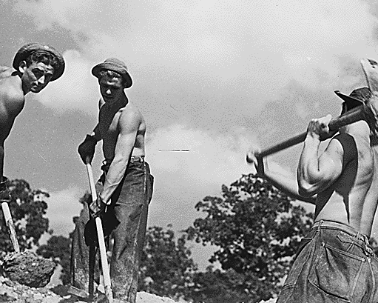
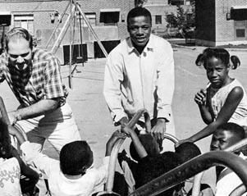
INSTANT RECOGNITION
The "A" shows communities that members are there to serve.
PROGRAM PERSONALITY
The "A" helps spread the mission of Homes for All and what we're about.
SENSE OF BELONGING
Promotes unity and cohesion among the members serving in a variety of ways.

Slide 18
AmeriCorps Gear
CLOTHING + APPAREL
Homes for All will provide a t-shirt, sweatshirt, and other apparel as it becomes available. Any item produced by your site should have the AmeriCorps Logo on it.
ITEMS FROM HOMES FOR ALL
Homes for All also provides stickers, pens, vinyl decals, and lanyards.
ITEMS FROM SERVICE SITE
Any nametag, business card, or other printed material (website) should have the AmeriCorps logo and clearly identify you as an AmeriCorps member.

Slide 19
Why We Are Proud AmeriCorps Members
Making A Difference
Movement
Community
Development

Slide 20
BUILDING HOMES,
BUILDING OPPORTUNITIES
our little catchphrase

Slide 21
HOMELESS AND HOUSING COALITION OF KENTUCKY
AmeriCorps State
AmeriCorps VISTA
Supportive Housing Programs
Advocacy and Education
Notes:
HHCK is the only state‐wide advocacy organization for issues of homelessness and affordable housing, HHCK is a coalition of organizations and individuals working together to eliminate the threat of homelessness and fulfill the promise of safe, decent, and affordable housing for all Kentuckians.
Advocacy
As an active lobbying organization, advocacy has been the main priority of HHCK since 1987. We plead the case for affordable housing initiatives to meet the needs of low‐income Kentuckians, and focus on educating the public and legislature about housing and homeless issues. HHCK’s advocacy victories include the creation of a permanent funding source for the Kentucky Affordable Housing Trust Fund and expansion of the Homelessness Prevention Project. HHCK is also a member of many advocacy coalitions, including the Healthy Homes Coalition, Kentucky Coalition for Responsible Lending, and the Kentucky Sustainable Energy Alliance.
Permanent Supportive Housing
HHCK offers multiple supportive housing programs for homeless individuals and families with disabilities. Referrals for the supportive housing programs are made through the Kentucky Balance of State Coordinated Entry and Referral System. Our programs can serve people across the state and are available in all Kentucky counties with a referring agency, except Fayette and Jefferson Counties, which have their own programs. Two programs focus on Balance of State Region 6. Participants receive supportive case management along with their housing voucher.
Homes for All AmeriCorps and VISTA
Homes for All VISTA and AmeriCorps are two national service projects administered by the Homeless and Housing Coalition of Kentucky. Our AmeriCorps program has been providing housing services at various housing organizations in the Commonwealth for over twenty years. The Homes for All VISTA project launched in June of 2016.
HHCK’s programs are the only housing and homelessness-focused AmeriCorps and VISTA program in Kentucky. The foc

Slide 22
Homes for All in Kentucky

Slide 23
Making the Most of Your Service
Opportunity to do things you might not ever do again
Work outside of your comfort zone
Not necessarily a 9-5 (but boundaries are important!)
Get out what you put in
Service is essential to our communities and you play a vital role!
People depend on you, your organization, services
Be present and give it your best effort

Slide 24
AmeriCorps Alumni Continuing Their Service and Commitment
Longitudinal studies show AmeriCorps alums:
are more connected to their communities
continue to participate in community activities
choose public service careers in disproportionately high levels

Slide 25
BE PRESENT
ASK QUESTIONS
CONNECT

Slide 26
CONTACT US
WEBSITES
www.hhck.org
America Learns
MyAmeriCorps.gov
EMAIL ADDRESS
homesforall@hhck.org
hdennis@hhck.org
cbottoms@hhck.org
PHONE NUMBER
502.223.1834 ext. 103 (Holly) or 125 (Caitlin)

Slide 27
FACEBOOK
TWITTER
INSTAGRAM
Homes for All AmeriCorps
@homesforallac
@homesforallac

Slide 28
Training + Housekeeping
Agenda overview
Bathrooms
Check-in and out
Food, drinks, fidgets, paper on table
Trash

