Slide 1
Site Supervisor Training
2022-2023 Program Year

Slide 2
AmeriCorps Program Staff
Caitlin Bottoms AmeriCorps Program Director
Holly Dennis AmeriCorps Member Coordinator

Slide 3
AmeriCorps 101
Like Marine Corps, core of the earth, apple core

Slide 4
AmeriCorps Overview
Federally funded national service program since 1994
Supported by the Serve Kentucky state commission
22+ AmeriCorps programs in Kentucky
Homes for All is the only KY program primarily focused on housing and homelessness
Goal is to provide services to 2500 individuals and house 1000 of them
Categories of AmeriCorps member:
Construction
Homeless Services
Housing Services
Terms of service:
August 1st until July 31st
1700, 1200, or 900 hour slot types

Slide 5
2022-2023 AmeriCorps Sites
Arbor Youth Services (Lexington)
Beattyville Housing
Bethany Haven (Bardstown)
CAReS (Ashland)
Community Action Council (Lexington)
Elizabeth’s Village (Georgetown)
Family Scholar House (Louisville)
Frontier Housing (Morehead)
Gateway Homeless Coalition (Morehead)
HHCK (Frankfort)
Housing Opportunities of Northern Kentucky (Covington)
Hope’s Wings Domestic Violence Program (Richmond)
Lexington Fair Housing Council
Paducah Alliance of Neighbors
Partnership Housing (Booneville)
Red Bird Mission (Beverly)
Safe Harbor (Ashland)
Shelter of Hope (Ashland)
Simon House (Frankfort)
St. John Center (Louisville)
The Nest (Lexington)
The Sunshine Center (Frankfort)

Slide 6
Service Language
AmeriCorps Member
Term of service
Living allowance
Never:
Hire
Work
Intern
Employ

Slide 7
Partnering with the AmeriCorps Program

Slide 8
HHCK’s Role
at the program level, we will
Administer the federal grant in full compliance of regulations
Complete all necessary member background checks
Train and orient members
Provide support to sites and members
Encourage member development
Report on program goals and member progress to AmeriCorps
in partnership with you, we will
Ensure AmeriCorps members are eligible and enrolled to begin service
Supervise and mentor members
Guarantee member safety
Support goals of the Homes for All AmeriCorps program

Slide 9
Service Site Role + Key Responsibilities
Provide quality supervision and mentorship
Offer the tools to be successful
Office space, equipment, technology, access to internet
Support data collection and performance measure reporting
Communicate regularly with our staff
Support the goals of AmeriCorps and the AmeriCorps member development
Ensure the member has sufficient opportunity to complete their term of service and required hours
37.5 hours per week

Slide 10
Recruitment + Finding A Member

Slide 11
Advertising + Interviewing
Guidance: Recruitment PDF and Video
We are:
Managing listings on 5 platforms
Screening applicants for eligibility
Forwarding to service sites when possible
Sites should:
Advertise and interview suitable applicants
Share information about AmeriCorps
Recommend candidates to HHCK using form
Challenges:
AmeriCorps benefits can be a barrier
Ghosting

Slide 12
Member Paperwork + Enrollment
Paperwork
MyAmeriCorps Application
Signwell electronic paperwork packet
National Service Criminal History Check
Fingerprint-based FBI Check
Enrollment
Form in MyAmeriCorps within 5 days of starting service
First Day of Service = First Day Hours Served
Last day to begin a 1700-hour member = September 12th

Slide 13
Member Orientation

Slide 14
Before the Member Arrives
Explain AmeriCorps program and member role to other staff
Order member business cards with AmeriCorps logo (if you’re able to)
Create an email address for the AmeriCorps member
Check in with member frequently and provide:
Directions to office
Expectations for the first day – i.e. what time?
Contact HHCK with any questions

Slide 15
Service Site Orientation
Welcoming the AmeriCorps member
Introduce to other staff, tour, lunch/break
Housekeeping items
Office logistics, supplies, parking, mail, phone, email, server, keys
Position training
Detailed on how to complete their responsibilities successfully
Member and Site Expectations Agreement
Review, sign, send to our office
First month:
Training
Reading
Listservs, standing calls, meetings, etc.

Slide 16
AmeriCorps Orientation
Details:
August 17th-19th
Capital Plaza Hotel in Frankfort, KY
Mileage reimbursement, meals, lodging provided
Agenda:
AmeriCorps 101
Understanding the service commitment
Housing and homelessness issues in Kentucky
Policies, procedures, prohibited activities
Member development
Self-care
Boundaries and ethics
Teambuilding

Slide 17
Member Service Year

Slide 18
Terms of Service
Program Year
August 1st to July 31st
Hour Requirement
1700, 1200, 900
Weekly Schedule
Determined between you and the member
Must account for approximately 37.5 hours per week
Leave
10 personal/vacation
10 sick
11 holidays

Slide 19
Member Benefits
Living allowance - $19,000
Education award - $6,495
Professional development
Health insurance – premium paid by us
Childcare assistance
Workers compensation
Student loan forbearance
Student loan interest paid
Member Assistance Program

Slide 20
Member Position Description
Defines AmeriCorps service year
Service site activities (90%)
Program activities (10%)
Training and events
Reporting
Communication
Minimum eligibility
Minimum requirements
Essential functions

Slide 21
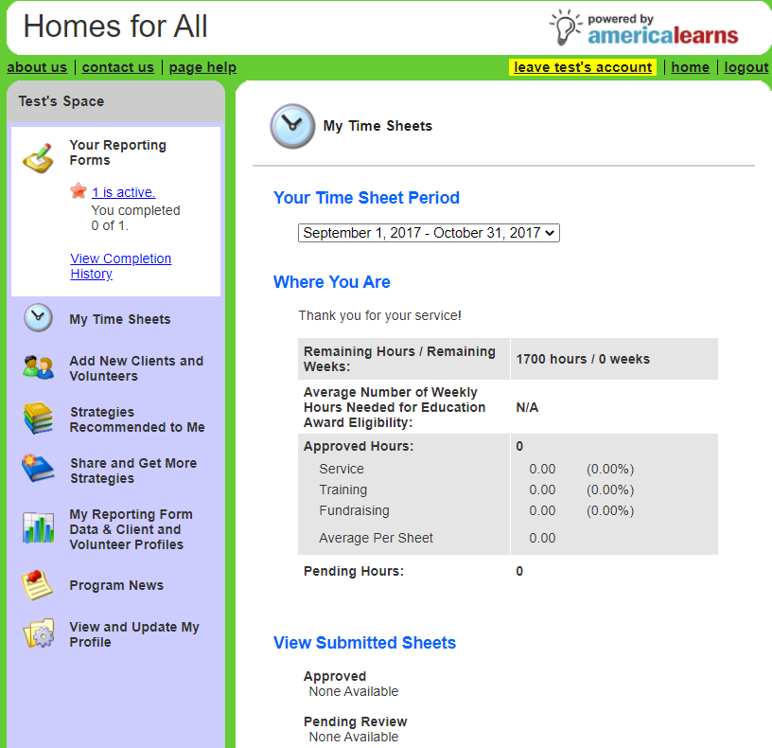
Timesheets
Submitted weekly
Phone app coming this fall
Supervisors approve at least 1x/month

Slide 22
Performance Measures: What’s Reported
Number of Individuals Served (meaningful engagement)
Household size
Demographics
Number of Individuals Housed
Proof of housing
Volunteers
Number of volunteers
Episodic vs. recurring
Number of hours
No identifying or confidential information

Slide 23
Reporting on Performance Measures
Member Responsibility
Report by the 15th of the month for previous month (i.e. November 15th for October updates)
Respond to and complete requests as soon as possible
Our Responsibility
Train members (initial, ongoing, one-on-one)
Review reports submitted regularly
Report to AmeriCorps
Site Responsibility
Support efforts to receive performance measure data
Provide time for member to work on reporting regularly
Submit any missing data – particularly if member exits service early

Slide 24
Program Evaluation – Central Kentucky
Assessing the impact of the AmeriCorps member
Sites
Arbor Youth Services
Community Action Council
Elizabeth’s Village
Homeless and Housing Coalition
Hope’s Wings
Simon House
Sunshine Center
The Nest

Slide 25
Member Development
Purpose:
Intentionally participate in the AmeriCorps program
Strengthen active citizenship
Encourage civic engagement mindset
Goal setting and reflections
4 Components
MLK Day of Service
Spring Service Project (construction)
Homeless Services Activity (K-Count, etc.)
Public Speaking Activity

Slide 26
Other Training + Events
Monthly Member Training
Content: program updates + special topic
Topics may include Crisis Prevention and Intervention, Trauma Informed Care, Implicit Bias, Time Management, Resiliency
AmeriCorps Launch
October 26th and 27th
Site Visits
Fall + spring (if needed)
AmeriCorps Week
March 2023
End of Year Training
Summer 2023
AmeriCorps training and events are required, agreed to fulfill in their service agreement, and part of the 10% reserved from the AmeriCorps member’s hours

Slide 27
Member Supervision and Support

Slide 28
Member Supervision
Provide a comprehensive training and orientation for your member
Review all relevant policies and procedures BEFORE the member begins serving people directly
Dedicate time to meet with your AmeriCorps member each week
Serve as supervisor, coach, and mentor
Ensure timely approval of member timesheets
Complete member evaluations twice per year
Notify Homes for All immediately of any changes in supervision
Regularly communicate with our staff

Slide 29
Member Evaluations
2 times per term of service
Mid-service
End of service (year)
2 components
Program performance
Service site performance
What to include
Positive feedback
Constructive feedback
Nothing new

Slide 30
How Organizations Can Develop + Support Members
Formal
Trainings
Professional Development Opportunities
Staff Meetings/Retreats
Informal
Incorporate with weekly check-ins
Open door policies
Mentorship

Slide 31
AmeriCorps Member Support
Living Allowance Increase
Maximum of $33,004
Housing
Food/gifts
Clothing/Promotional items (agency logo apparel)
Health insurance
Ongoing training
Be fair and equitable in support to all AmeriCorps members serving with you!

Slide 32
Key Policies + Procedures

Slide 33
Prohibited Activities
While charging time to the AmeriCorps program, accumulating service or training hours, or otherwise performing activities supported by the AmeriCorps program or the Corporation, staff and members may not engage in the following activities:
(1) Attempting to influence legislation;
(2) Organizing or engaging in protests, petitions, boycotts, or strikes;
(3) Assisting, promoting, or deterring union organizing;
(4) Impairing existing contracts for services or collective bargaining agreements;
(5) Engaging in partisan political activities, or other activities designed to influence the outcome of an election to any public office;
(6) Participating in, or endorsing, events or activities that are likely to include advocacy for or against political parties, political platforms, political candidates, proposed legislation, or elected officials;
(7) Engaging in religious instruction, conducting worship services, providing instruction as part of a program that includes mandatory religious instruction or worship, constructing or operating facilities devoted to religious instruction or worship, maintaining facilities primarily or inherently devoted to religious instruction or worship, or engaging in any form of religious proselytization;

Slide 34
Prohibited Activities cont.
(8) Providing a direct benefit to –
(i) A business organized for profit;
(ii) A labor union;
(iii) A partisan political organization;
(iv) A nonprofit organization that fails to comply with the restrictions contained in section 501(c)(3) of the Internal Revenue Code of 1986 except that nothing in this section shall be construed to prevent participants from engaging in advocacy activities undertaken at their own initiative;
(v) An organization engaged in the religious activities described in paragraph (g) of this section, unless Corporation assistance is not used to support those religious activities; and
(9) Conducting a voter registration drive or using Corporation funds to conduct a voter registration drive;
(10) Providing abortion services or referrals for receipt of such services; and
(11) Such other activities as the Corporation may prohibit.
***Individuals may exercise their rights as private citizens and may participate in the activities listed above on their initiative, on non-AmeriCorps time, and using non-Corporation funds. Individuals should not wear the AmeriCorps logo while doing so***

Slide 35
COVID-19 + Teleservice
Members should serve on-site when possible
Need established supervisory structure if serving at home
i.e. hybrid schedules
Regular communication
Verifying hours
Vaccine expectations vs requirements
Health and safety protocols

Slide 36
Transportation + Mileage
Inform member of any transportation expectations at the start of service
Provide mileage reimbursement for client transport, home visits, etc. in personal vehicle
Keep a copy of their valid driver’s license and auto insurance for vehicle on file

Slide 37
AmeriCorps Branding
New logo in effect starting this year!
Use it on
Business cards, email signature, website
Your organization must identify itself as an AmeriCorps Service Site
We can send you signage!
Member needs to ALWAYS wear something with the logo
We provide gear

Slide 38
Safety
Anticipate and plan for safety issues
Workers Compensation Coverage through HHCK
Notify Holly or Caitlin immediately
Complete claim form
Submit to KEMI
Member mental health
Overdoses, death, etc.

Slide 39
Standards of Conduct + Disciplinary
Member Standards of Conduct
Level 1, 2, 3
Use Corrective Action Plan
Performance-based issues
Use Member Action Plan
Removal from service
Release from AmeriCorps only happens at the program level
Documentation needed

Slide 40
Wrapping Up

Slide 41
Next Steps
Service Site Agreement
Via Signwell
America Learns Account
Welcome email for new supervisors
Member and Site Expectations Agreement
Within first two weeks of member’s start of service
Site Contribution
Quarterly payment plan available

Slide 42
Upcoming Events
AmeriCorps Year Starts
August 1st
Member Orientation
August 17th to the 19th (required)
AmeriCorps Launch
October 26th-27th (required)
Site Visits
Fall 2022 (both members and supervisors)

Slide 43
HHCK Staff
Caitlin Bottoms – Program Director – cbottoms@hhck.org
General program questions, training, site support
Holly Dennis – Member Coordinator – hdennis@hhck.org
Member recruitment, training, support
Wendy Tucker – Director of Finance – wtucker@hhck.org
Site contribution, HHCK membership
502-223-1834
www.hhck.org
https://www.hhck.org/site-and-supervisor-resources
Tab: Homes for All AmeriCorps / Site and Supervisor Resources

