Slide 1

Building Economic Advocacy Strategies
Financial Education Core Competencies

Slide 2
Objective
  To understand concepts of personal financial management and strategies – including group and one-on-one activities - for ensuring that your clients understand the following:
  Financial goals
  How to create and manage a budget
  Credit management
  Financial services
  Student loan basics

Slide 3
The Empowerment Model
Emphasizes education, understanding of rights and resources and behavior change as a path to self-sufficiency
Recognizes and addresses the emotions related to money
Folks defines their own goals and and direct their own progress with the guidance of a trusted advocate
Provides people with lifelong knowledge and skills
Provide guidance based on FACTS

Slide 4
Economic Empowerment Advocates
Where do folks start?
What do they bring with them?
Where do they want to go?
Where do WE want them to end up?
What do we need to provide to create a bridge?

Slide 5
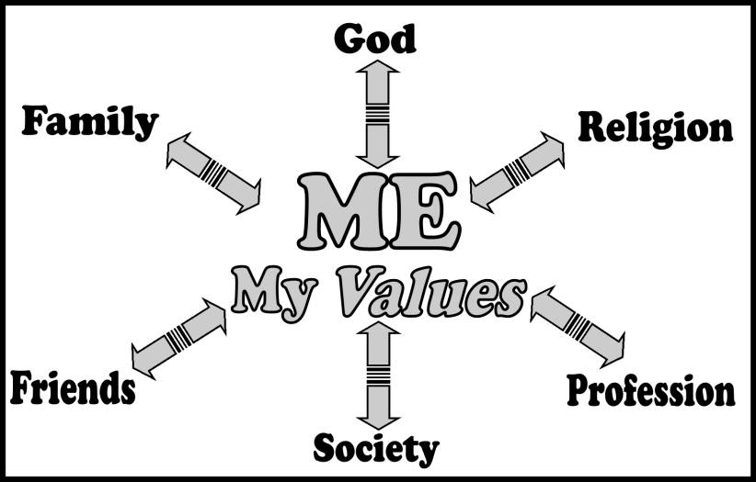
Behavioral Economics
An understanding of why we make certain decisions helps us alter our behavior/s to reach our goals more quickly and easily.
Consider how personal beliefs and experiences affect financial decisions
Identify patterns in financial behavior
Eliminate barriers and increase access to positive financial decisions

Slide 6

^{By identifying our} beliefs and attitudes about money and finances including origins, and supplementing that realization with new knowledge and skills, we can begin to change feelings and attitudes that are holding us back.

Slide 7
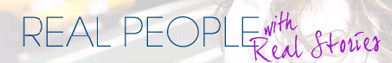
Take a moment to reflect on your personal beliefs and ideas about setting goals, particularly about money.
What messages were you given about money growing up?
How are those messages impacting you today?
Do you have a “life plan”? If no, why not?
If yes, in comparison to where you are now, how close are you to where you would like to be with your life plan, including personal finances?

Slide 8

Challenges to Financial Management

Slide 9

Pitfalls and Barriers
As we begin working toward self-sufficiency, it can be useful to identify which obstacles we create for ourselves – PITFALLS – and which obstacles are systematic – BARRIERS.

Slide 10

Activity
As a group, let’s brainstorm about some of the pitfalls and barriers clients you serve might encounter as they work toward self-sufficiency.
Remember: Pitfalls=what we cause for ourselves; Barriers=systemic issues/policies over which we do NOT have control

Slide 11
This activity can help clients identify barriers that are out of their control – racism, the economy - and pitfalls that they can work to overcome – self-doubt, lack of education – as they create goals and action steps.
“You’re braver than you believe, and stronger than you seem, and smarter than you think.” –A.A. Milne

Slide 12
Financial Education Modules
Module I: Goals
Module II: Budgeting
Module III: Credit

Slide 13

Module I: Goals

Slide 14

Defining Financial Goals
Financial goals can be . . .
  Short-term
    get current on bills, pay bills on time for 3 months, open bank account, review credit report, gather paperwork
  Mid-term
    Transportation (bike, car) purchase, pay off credit card balance, emergency savings fund
  Long-term
    home purchase, education fund, retirement savings

Slide 15

SMART Goals
Remind you what is most important to you
Keep you focused and help you make spending decisions
Help you develop clear action steps
Help you identify resources you might need

Slide 16
SMART Goals Activity
SMART Goals: Let’s Practice!
Identify one financial goal you would like to achieve in the next year
Write down at least 3 to 5 action steps needed to achieve that goal
What can you do today to work toward that goal?
Next week?
Next month?
In the next six months?
Need a SMART Goal template? Google it! There a few different versions out there so use what you think would work best.
Or, create your own!

Slide 17

Goals should be written down and should include:
Action steps
Resources required
Review often and
revise as necessary!

Slide 18


Slide 19

Financial Case Management
Setting financial goals can lead to:
Having a plan for spending and saving money
Feeling more financially secure
Being able to pay bills when they are due
Having 3-6 months of living expenses saved (emergency savings)
Being free of credit card or other debt
Attending post-secondary education (self or family)
Owning means for transportation
Home ownership

Slide 20
Effective Case Management: Overcoming Barriers
Step One: Help your client become informed.
Step Two: Assist in the evaluation of personal finances. Look for ways to save money immediately.
Step Three: Discuss and prepare for best and worst case scenarios.
Step Four: Set goals and take action.
Step Five: Follow the plan and adjust as needed.
Begin with baby steps. Meet regularly. Have a goal for each meeting and an overall goal plan!

Slide 21
Things to Consider: Goals
Help clients articulate- Where are you now? Where do you want to be?
Focus on Realistic Goals
Celebrate Small Victories
Define “stability” in real terms, quantifiable goals when folks say it’s their goal
Provide good tools and encouragement

Slide 22

Module II: Budgeting

Slide 23
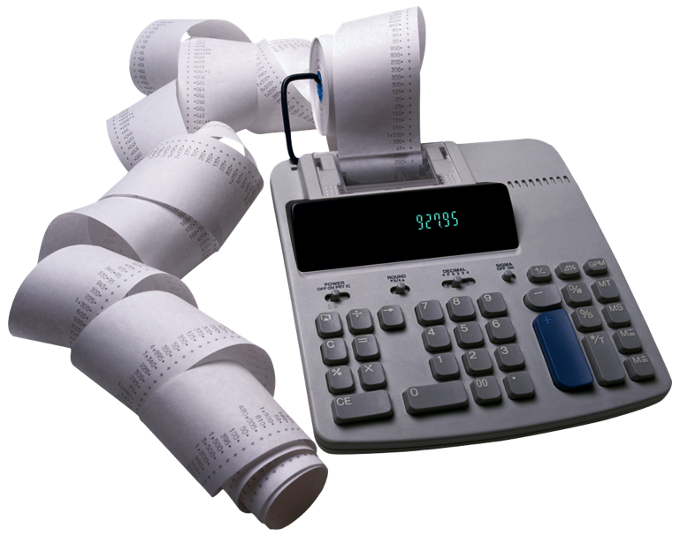
Spending & Savings Planning

Slide 24

In order to become or remain self-sufficient or to reach your financial goals, you must:
Understand your spending
Determine ways to save
Create a spending & savings plan (budget) and stick to it!

Slide 25
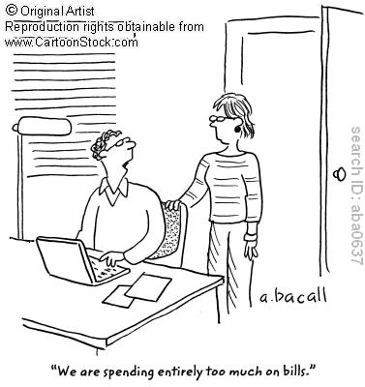
Income & Expenses
A “spending plan” is a plan for using your income to meet your monthly financial obligations and cover all other expenses.

Slide 26
To create a spending plan…
You must know the following:
  Income
    Be sure to use NET income (after all payroll deductions) and to calculate accurately
  Fixed expenses
    Don’t forget to include periodic expenses such as car insurance or trash pick-up
  Variable expenses
    Some variable expenses can be turned into fixed expenses
    INCOME – (FIXED + VARIABLE EXPENSES)

Slide 27
Strategies
Pay yourself also!
  Budget for savings. Shoot for 10%, but save something regularly - even if it is $5/month.
  Set up direct deposit.

Slide 28
Spending Habits
What we think we spend and what we actually spend are often different!
Ask clients to keep track of their spending for one week, then for one month, without leaving anything out.
  Give folks the tools to do this: envelopes, notebook, calendar, etc.
BE AWARE:
DV survivors have often had their spending controlled or monitored by their abuser, so this exercise may be a trigger. Explain the purpose of this exercise, that it is voluntary, and that you will not be “monitoring” their spending.

Slide 29

Marketing Spending
It can be helpful for your clients to be aware of the ways that consumers are compelled to spend by marketing and advertising.
You can discuss marketing strategies that lead us to purchase more expensive products, more of an item than we really need, etc.

Slide 30

Activity –
Spending Leaks
Identify your particular Spending Leak, calculating how much is spent each year on that item.
Brainstorm ways to eliminate or reduce several spending leaks.
Determine how much could be saved each year.
Discuss how that extra money might be utilized toward goals.
Item: ____________
Cost of item X number of times purchased in a week = Y
Y x 52 (weeks in a year) = Spending Leak
Item: Starbucks Coffee
Cost of item ($5) X number of times purchased in a week (3) = $15
$15 x 52 (weeks in the year) = $780

Slide 31

This activity shows how even the smallest “leak” can add up to a lot over time, and how reducing or eliminating seemingly small expenses can free up significant funds.
It can also help participants identify ways to avoid the spending leak.

Slide 32
Help clients live within their budget by helping them…
Increase Income
Decrease Expenses
Look for a job with better earning potential or for supplemental income
Request a raise at their current job
Apply for public benefits
Claim the CTC, EITC and budget the tax refund
Look for free community activities
Comparison shop and use coupons
Explore housing subsidies
Consider less expensive transportation
Apply for LIHEAP

Slide 33
Tips for a successful spending plan
Failing to plan
is planning to fail!
  Plan ahead to stay within your spending plan
  Plan meals and shop smart
  Plan for treats, special occasions (birthdays), or infrequent expenses (back to school)
  Use a “zero balanced” plan
  If you get off track, don’t panic!

Slide 34
Things to Consider: Budgeting
Be aware of the emotional impact some of this content can have.
Emphasize how to prioritize budgeting expenses ex. Housing related first, etc.
Trust yourself to walk through this content with the client. Don’t expect your client to know what they don’t know
You’re Planting Seeds: not everything you share will be used immediately
Teach clients how to budget any and all money-SNAP, SSI, imaginary (zero balanced). This is the importance of the skill regardless of present income
Give helpful tools to make it tangible (calendar, envelopes, etc.)
Encourage sharing, share yourself (but don’t overshare! Strike a balance.)
Play games
Avoid hypotheticals-keep it real

Slide 35

Module III: Credit and Debt

Slide 36
CREDIT AND DEBT
Understand credit, credit report, credit score
Read a credit report
File disputes
Negotiate debt payments
Use credit wisely

Slide 37
Would you lend to me?
Utility bill 45 days late.
Paid off car loan early.
On-time student loan payments for 15 months.
2 of 3 credit cards nearly maxed out.
$13,500/year salary.
$1000 in savings account.
Medical debt in collections.
Have one credit card, student loans, and mortgage.

Slide 38
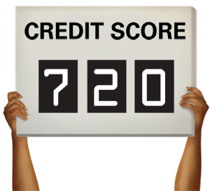

A credit report is a complete listing of your current and past debts. It includes valuable information about your accounts and payment history.
A credit score is a numerical calculation of several factors in your credit report at any given time. It is a way to represent your financial history and behavior. FICO credit scores range from 300 – 850.

Slide 39



The most effective way to monitor your credit report for accuracy is to pull a free report from one of the three bureaus every four months at www.annualcreditreport.com.
For example:
January
May
September

Slide 40
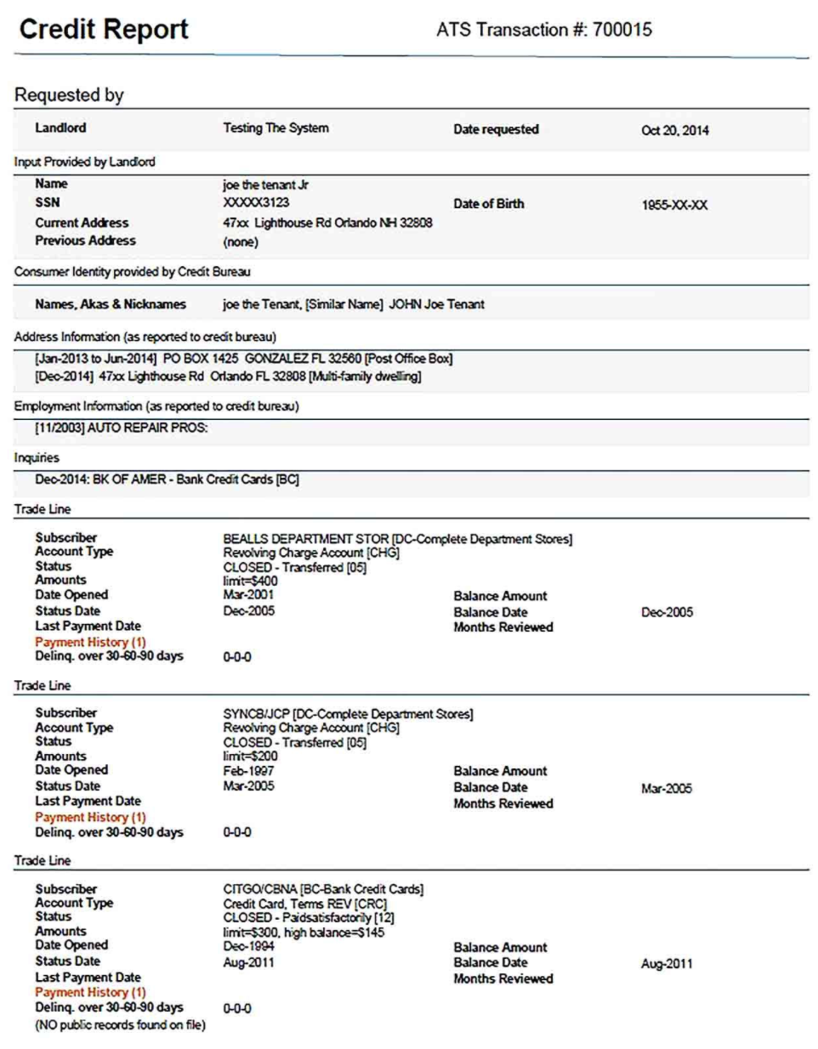
Reading Credit Reports

Slide 41
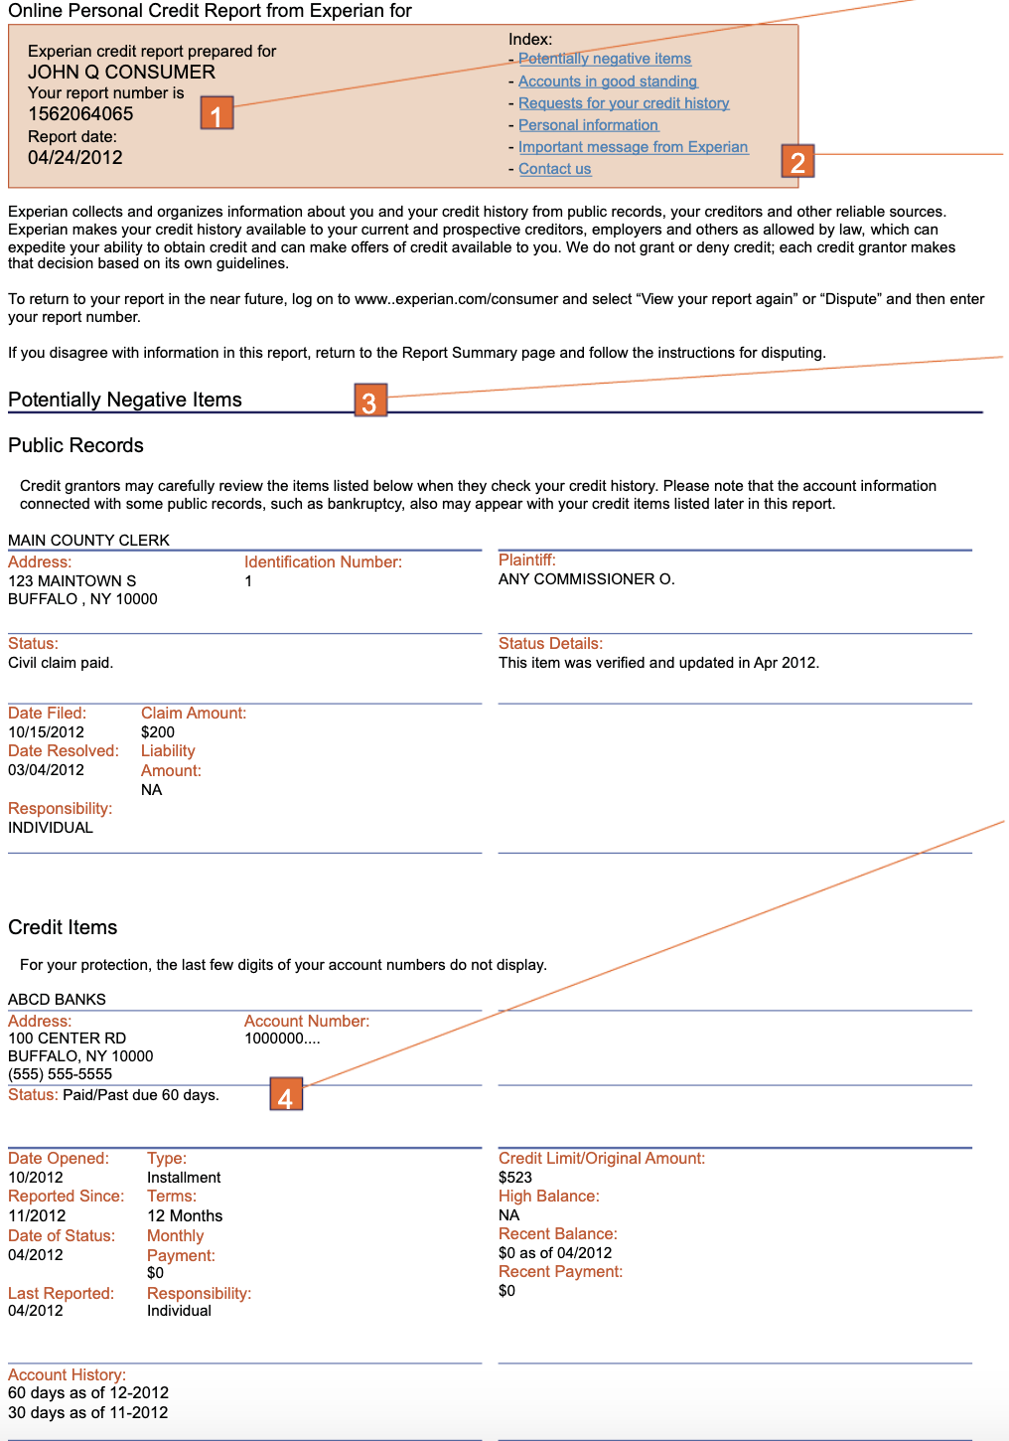
Reading Credit Reports

Slide 42
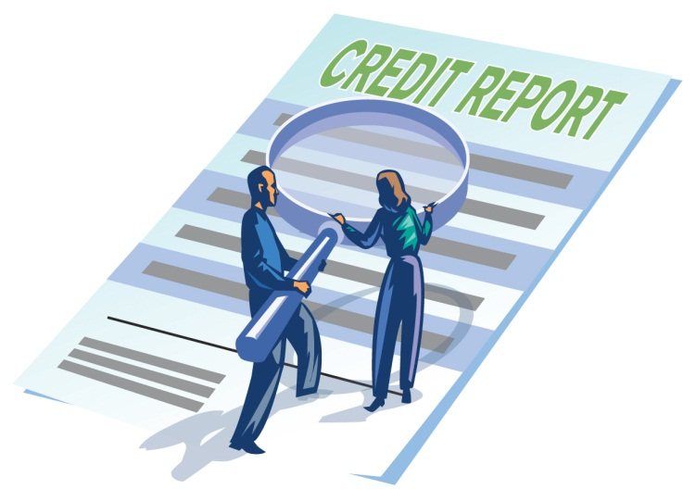
How your credit score is used
In addition to determining interest rates on mortgages, car loans, personal loans, and credit cards, your credit score and history may be used by:
  landlords
  potential employers
  insurance companies

Slide 43
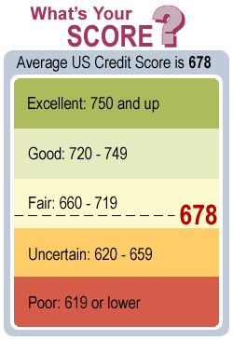

Slide 44
Consumers with “bad credit” (financial trustworthiness) typically pay thousands of dollars more in interest over their lifetimes than those with “good credit”.
FICO® score | APR [?] | Monthly payment *
760-850 | 4.061% | $481
700-759 | 4.283% | $494
680-699 | 4.460% | $504
660-679 | 4.673% | $517
640-659 | 5.102% | $543
620-639 | 5.647% | $577
Rates for a 30-year, $100,000 mortgage in Kentucky:
A 100 point difference in your FICO® score could mean over $40,000 extra in interest payments over the life of a 30 year mortgage on a $300,000 home loan.
QUESTION: What are some things that affect your credit score?
Notes:
$96 per month difference between the worst credit scores and the best. = $1152 / year. Between 620-639 and 680-699 = $73/month, $876/year

Slide 45
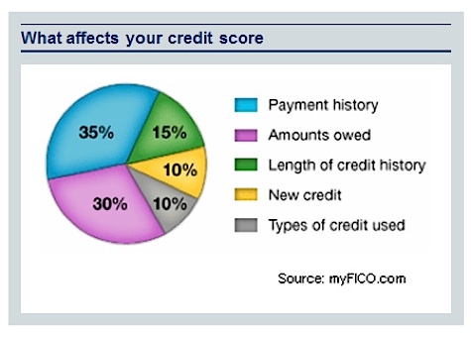
Lenders use a credit score to
predict your financial behavior and assess risk.

Slide 46
What affects a FICO score?
Payment history – 35%
  Have debts been paid on time? How often have payments been late? How late have payments been? How much has the consumer been delinquent with?
Amounts owed – 30%
  How much total debt? How much credit is being carried in relation to credit limit?
Length of credit history – 15%
  How long has the consumer had credit?

Slide 47
What affects a credit score?
(Cont’d)
New credit – 10%
  Have new lines of credit been opened recently? What kind and for how much? Has the consumer been trying to get more credit?
Types of credit used – 10%
  How many credit or store cards? How many auto loans? Any mortgages or student loans? Can this consumer manage different types of credit?
If you wanted to improve your credit score what steps could you take?

Slide 48
In general …
Negative information that is accurate – Remains on the credit report for 7 years but becomes less important as time passes.
85% of the factors comprising your score can be controlled by you!
There are laws in place to protect your rights as a consumer.
Resources to use for consumer rights include the Consumer Financial Protection Bureau (CFPB): www.consumerfinance.gov

Slide 49

Steps to (re)establishing good credit…

Slide 50
Review credit report for accuracy : Identity errors, accounts you don’t recognize, late payments that were actually on time, incorrect balances
Dispute errors in writing. How? www.consumerfinance.gov/ask-cfpb/how-do-i-dispute-an-error-on-my-credit-report-en-314/
Pay all of your bills on time! This is the single most important factor in improving a credit score.
Keep credit utilization rate under 10%-30%
  What does this mean?

Slide 51
Pay past-due accounts with collateral attached (car loans, mortgages)
Pay down old debts/collections. Consider the amount and age of the debt. More recent activity carries more weight; as debt ages it affects the credit score less.
Keep unused accounts open! Closing them shortens your credit history.
  Diversify credit sources (have more than one type/line of credit).
  Get on a payment plan for medical debt- how?

Slide 52
  Pay credit cards before the due date to make sure payments are posted before credit bureau reporting.
  Request a “good will” deletion for an unusual late payment.
  Negotiate with collection agency to “not report” in exchange for payment.
  Negotiate a settlement.
  ONLY use non-profit debt management agencies such as Apprisen www.apprisen.com

Slide 53
Prioritizing Debt
High Priority
Always pay family necessities first – food, unavoidable medical debt, etc.
Pay housing-related bills.
Pay the minimum required for essential utility services.
Pay car loans unless you can consider selling your car.
You must pay child support.
Income tax debts are high priority.
Mid-Low Priority
Government student loans are medium-priority debts.
Loans without collateral are low priority.
Loans with household goods as collateral (e.g., furniture, washer/dryer) are low priority.
Co-signed debts should be treated like other debts.

Slide 54
Debt Snowball:
A Strategy for dumping debt
Smallest balance first
High interest first
Pay the minimum balance on all but pay the smallest balance.
Pay more than minimum balance on the smallest debt.
When the smallest debt is paid off, re-direct those payments into the next highest debt.
List all interest-bearing debts with balance, interest rate, and payoff date at current rate of payment.
Make extra payments to the debt with the highest interest rate.
When that debt is paid, re-direct extra payments to next highest interest rate.

Slide 55
Learning Check
TRUE OR FALSE
There is no need to request your report/score from all three of the credit bureaus because they are all the same.
Your payment history is generally the most important factor in determining your credit score.
There are no laws in place to protect your rights as a consumer who uses credit.
When you request a copy of your own report from one of the three bureaus, it lowers your credit score.
You cannot be approved for credit without a credit history.
A creditor will not settle for less money than you actually owe on a delinquent account.
Most negative information remains on a credit report forever.

Slide 56
Things to Consider: Credit
Why should it matter to folks you’re working with?
Always pull a report when you can
Prioritize issue on Credit Report- don’t overwhelm your client with too much information
Use HHCK, CFPB, Apprisen, etc. as a resource if you’re having trouble. Credit can be complex!
Remember- Even if credit isn’t something a client can work on now you’re planting seeds for their future.

Slide 57

Financial Products & Predatory Lending

Slide 58

Mainstream Financial Services
Banks
Credit Unions
Fringe Financial Services
Check cashers
Payday lenders
Rent-to-Own
Auto title loans
Some commercial tax preparers
  Refund anticipation loans
  Refund anticipation checks

Slide 59
Mainstream Financial Services
Banks
For-profit entities that accept deposits and channel money into lending activities
Serve the general public
Traditional banks issue stock and are owned by stockholders (shareholders)
Insured by Federal Deposit Insurance Corporation (FDIC)
Credit Unions
Community-based financial cooperatives offering a wide range of services
Serve their members, who must be within the field of membership defined by the credit union’s charter
Owned and controlled by members, who are also shareholders
Insured by the National Credit Union Insurance Fund

Slide 60
Considerations
What are your banking needs?
Compare services.
How comfortable are you with the staff and branch locations/hours?
What services and products are available? What are the fees?
Phone services?
Internet services?
Does the bank meet your cultural needs?
Where are the ATMs and what are the fees?
Safety of money – FDIC or NCUSIF logo?

Slide 61
While some banks may charge monthly or annual fees or require a minimum balance, alternative financial services are often predatory and take advantage of lower-income households.

Slide 62
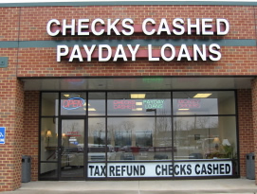
Check Cashers
Check cashers may charge a flat fee for cashing a check, or a percentage of the amount of the check.
If you have a bank account, the same service is free.

Slide 63
Payday Lenders…
…expect their customers to be unable to pay. If you cannot re-pay the loan within the given time (usually 14 days), a new fee is assessed on the total amount, and interest is calculated on the new amount.
Notes:
If you borrow $500, on day 15, you owe $619. Let’s assume you can only repay $319. The lender will extend the loan for $319, plus a fee ($73.40), for another two weeks. At the end of the month you still owe $392. IF you repay the remainder at this time, you have paid $

Slide 64
Amount Borrowed | Fee | You Pay | APR
$100 | $27.80 | $127.80 | 357.429%
$200 | $50.60 | $250.60 | 325.286%
$300 | $73.40 | $373.40 | 314.571%
$400 | $96.20 | $496.20 | 309.214%
$500 | $119.00 | $619.00 | 306.000%
These rates are advertised on the website of a Virginia payday lender, and are based on a 14-day payoff.
Payday loans can become debt traps.
They are marketed to lower-income individuals and families because they are convenient and do not require a credit check. Borrowers often cannot repay the loan within two weeks and meet their regular financial obligations. The lender extends the loan, while fees and interest continue to build on the original amount.

Slide 65

Rent-To-Own
$79 x 12 months = $948
This product sells at major retailers for about $150 - $200.

Slide 66

Auto Title Loans hold your vehicle as collateral for the loan because it requires you to sign over the title.
Typically, loans are due to be paid in full within 30 days.
Interest rates can be as high as 250% APR.
Failure to repay can result in repossession of your car.

Slide 67
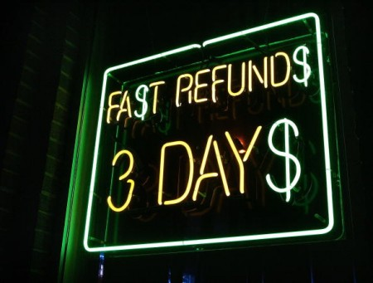
Commercial Tax Preparers
Many tax preparation companies charge very high fees for relatively simple tax returns.
Many paid preparers market to lower-income households by promising “quick refunds” or “no up-front fees.”
Paid preparers target lower-income households for high-interest Refund Anticipation Loans.
THERE’S (almost) NO REASON TO PAY TO HAVE YOUR TAXES PREPARED FOR YOU.

Slide 68
Other Tips for Economic Advocacy
Know your local resources.
Use volunteers.
  Many financial professionals are willing to lead workshops or even advise clients on an individual basis.
  Be sure to brief them about some of the unique issues facing your clients
  Befriend bankers
    Work with financial professionals to make services/products more easily accessible to your clients
    Reach out to local businesses:
      Request donated goods or services to use as incentives.

Slide 69

Student Loans 101

Slide 70
Why does this matter?
Four out of five U.S. households have student loans
One Trillion dollars are outstanding
Bankruptcy highly unlikely (undue hardship)
Can keep people from pursuing further education which can increase income opportunities

Slide 71
Terms based on credit
Often variable interest rates with no cap
Borrowing a private student loan
Lack borrower protections
Lack flexible repayment terms

Slide 72
Private loans
Types are commercial, alternative, school as lender, state loans
Not subject to federal regulations
Not listed on any centralized location but can be on credit report
Can go into default with one missed payment
Difficult but not impossible to bankrupt
Don’t usually settle

Slide 73
Financial Need
Dependent vs. independent students
Borrowing a federal student loan
Individual eligibility
Institutional eligibility

Slide 74
Federal loans
Guaranteed by federal government; no prepayment penalties
Listed on www.nslds.ed.gov; need PIN; shows type and status
Default usually happens when people fail to pay attention or lack information
Entire loan balance becomes due upon default
Very large collection fees assessed (18% added to principal and capitalized)
Power of federal government to collect

Slide 75
Types of Federal Student Loans
Perkins
Subsidized Stafford
Federal Consolidation
Federal
Student
Loans
Parent PLUS
Unsubsidized Stafford
Grad PLUS

Slide 76
Federal Loan Info
DYK there are student loan limits? They are based on dependent or independent student status
Aggregate max for dependent students = $31,000
Aggregate max for independent students = $57,500
Aggregate max for graduate students = $138,500
  What does this mean?
Subsidized loans (financial need) do NOT accumulate interest before students begin to repay
Unsubsidized loans (available to anyone) accumulate interest from the time the money is first disbursed until it is paid in full

Slide 77




Español (Spanish)
Skip Navigation
Financial Aid ReviewExit CounselingGlossary of TermsBrowser Info/SetupFAQsContact Us
NSLDS Student Access site only supports the current 4-digit PIN standard. If you have a PIN that does not conform to this standard, please visit www.pin.ed.gov to establish a new 4-digit pin.
The National Student Loan Data System (NSLDS) is the U.S. Department of Education's (ED's) central database for student aid. NSLDS receives data from schools, guaranty agencies, the Direct Loan program, and other Department of ED programs. NSLDS Student Access provides a centralized, integrated view of Title IV loans and grants so that recipients of Title IV Aid can access and inquire about their Title IV loans and/or grant data.
Financial Aid Review
Exit Counseling

Slide 78
Delinquency vs. Default
Delinquency begins the first day after a missed payment
There are many pre-default repayment options to prevent default such as standard, graduated, extended, income sensitive, income contingent, income based
Always take action to prevent default
Resource www.studentloans.gov
Default begins when there is failure to make payments for 9 months when the payments were expected to be received
Can’t negotiate waivers for fees/interest after in default
Ineligible for new loans OR grants
Wages can be seized (without court order)
Other federal income can be seized (tax refunds, federal benefits, social security (Not SSI or VA)

Slide 79
Getting Out of Default
Repay the entire debt
Consider discharge/cancellation options
Consolidate (30-90 days) = make 3 reasonable affordable payments OR agree to select ICR or IBR; collection costs are added to loan balance
Rehabilitate (longer term) = removes “default” from credit but late payment history remains; 9 months of consecutive payments; can only be done once unless adding another loan

Slide 80
Postponing federal student loan repayment
Grace Periods
Deferments
Forbearances

Slide 81
Income Based Repayment
Consider in place of forbearance (where interest capitalizes and adds to your principal)
Delivers an affordable monthly payment based on AGI and family size
Considers 15% of discretionary income
Two possible paths to forgiveness: Payment based (20-25 years) OR Public Service Loan Forgiveness (120 consecutive qualifying payments)

Slide 82
Income Based Repayment
Family Size
Adjusted Gross Income
Single/MFS AGI = IBR AGI
MFJ AGI = IBR AGI
Tax Filing Status

Slide 83

Questions

