Slide 1
TIME SHEET REVIEW
For Supervisors

Slide 2
using it

Slide 3
TIME SHEET FLOW
01
02
03
04
Get Notified
America Learns will send an email notification when a Member submits or resubmits a time sheet.
Log In
Log in to America Learns.
Approve/Reject
Approve or reject Members’ time sheets.
Get On With Your Day
You’ve got important things to do.
Time sheets shouldn’t get in the way.

Slide 4
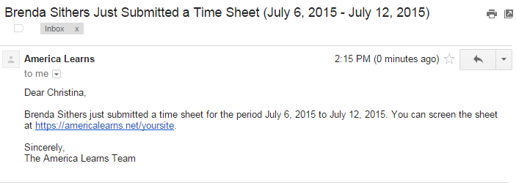
step1
GET NOTIFIED
America Learns will send an email notification when a Member submits or resubmits a time sheet.

Slide 5
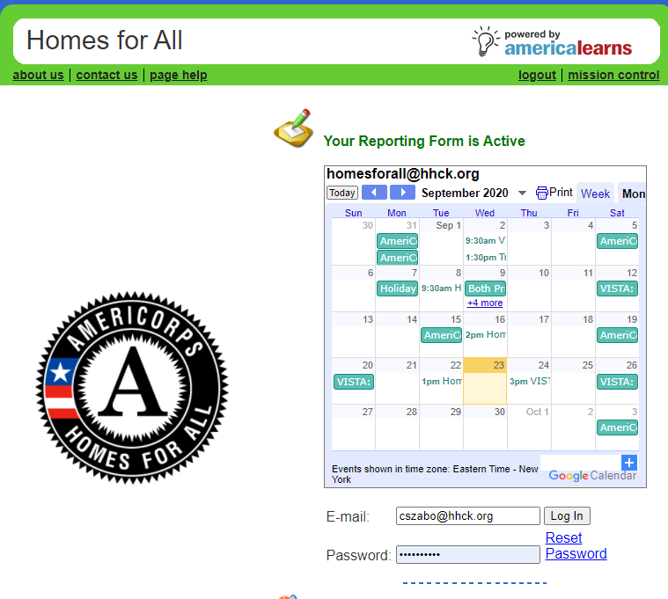
step2
LOG IN
Log in to your America Learns website here:
http://americalearns.net/homesforall
Program Calendar – so everyone always knows what’s coming up!

Slide 6
step3
APPROVE/REJECT SHEETS
Mission Control: Time Sheets
Click Time Sheets

Slide 7
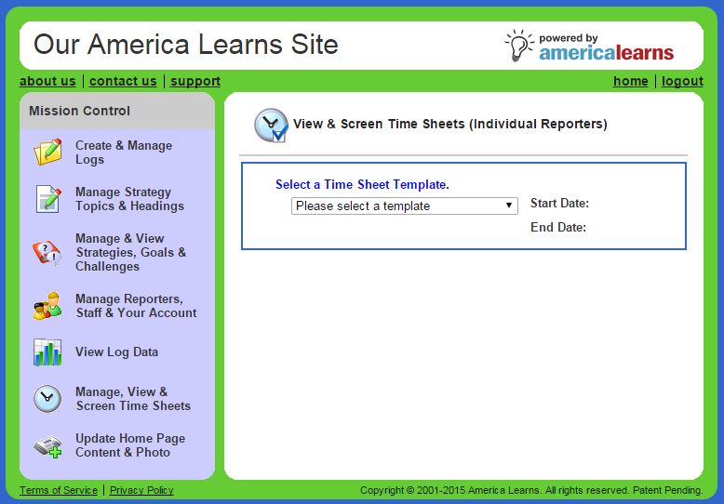
APPROVE/REJECT SHEETS
Select Current Template
Use the drop-down menu to select the correct template.
20-21 Program Year (AmeriCorps)
OR
20-21 Program Year (VISTA)

Slide 8
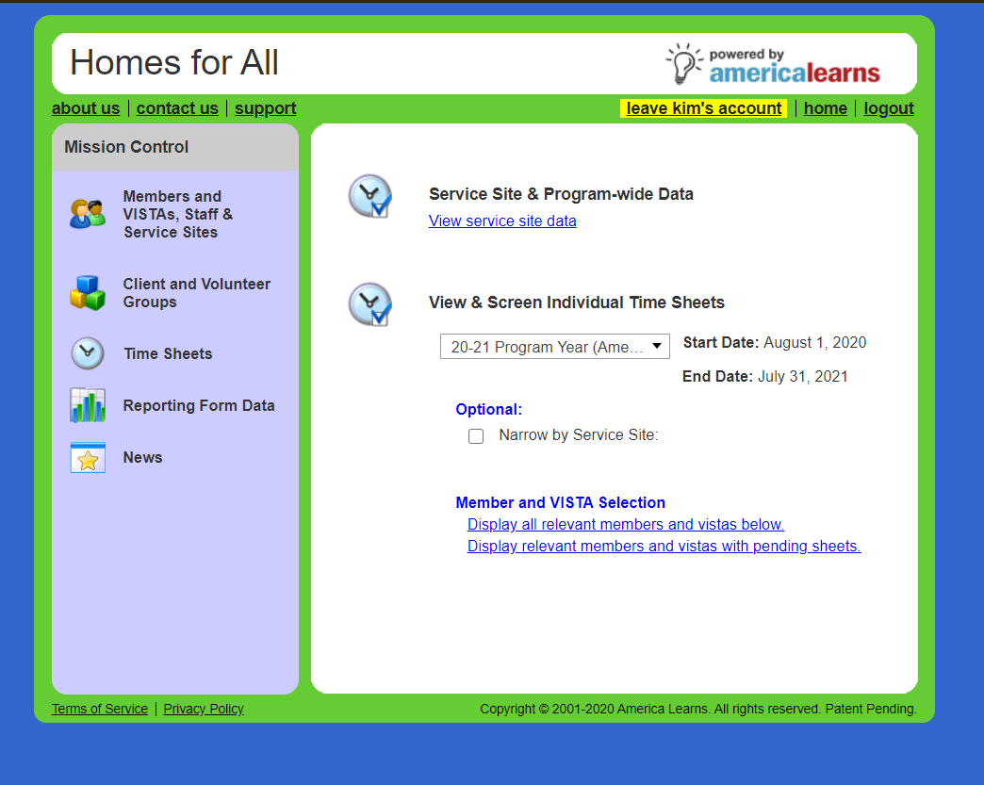
APPROVE/REJECT SHEETS
Display relevant Members with pending sheets.
1) If you supervise more than one site, you can use (not required) the Narrow by Host Site option.
2) Select the link in the Member Selection section that says Display relevant Members with pending sheets.

Slide 9
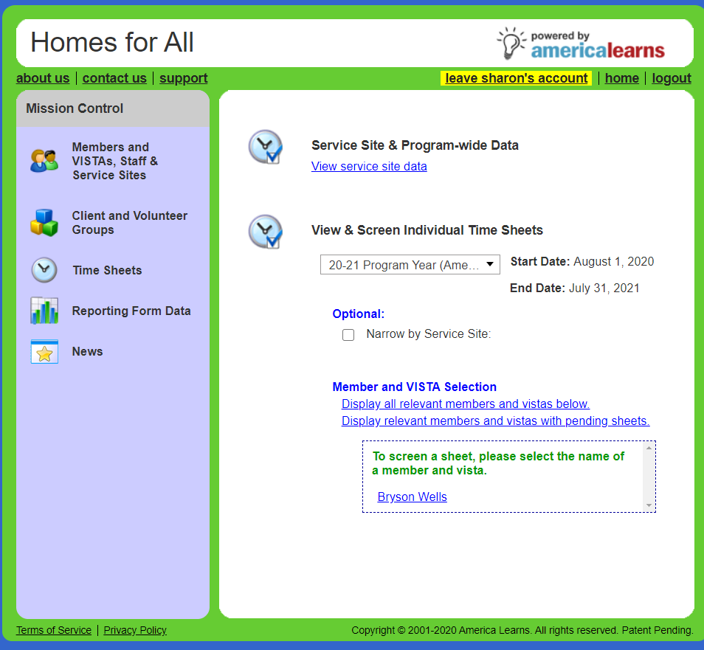
APPROVE/REJECT SHEETS
Member-by-Member
Click the Member’s name.

Slide 10
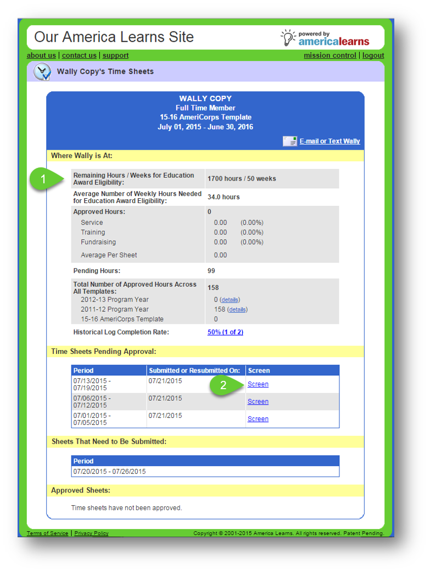
APPROVE/REJECT SHEETS
Member-by-Member
1) A summary of that Member’s time records thus far will be displayed.
2) In the “Pending Approval” category, click the Screen link.

Slide 11
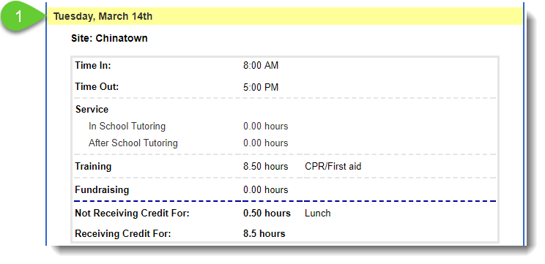
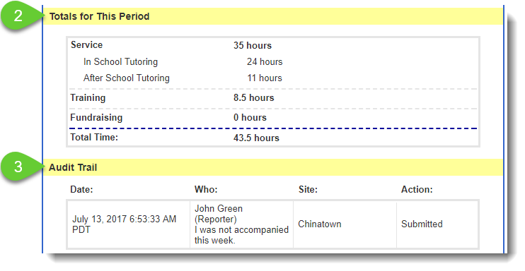
APPROVE/REJECT SHEETS
Member-by-Member
If you click the Period link to review or reject, you’ll see:
1) Day-by-day breakdown of that Member’s time
2) A summary of Totals for This Period
3) the Audit Trail

Slide 12
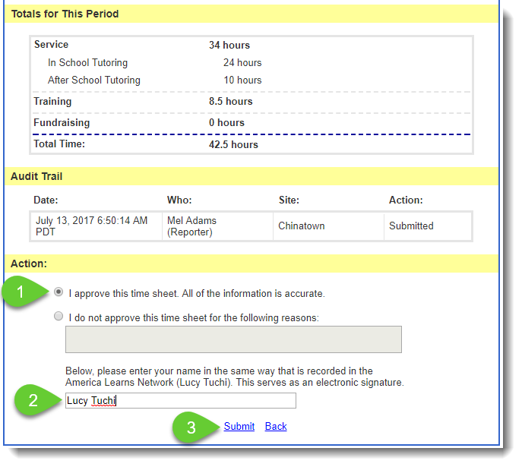
APPROVE/REJECT SHEETS
Member-by-Member
To Approve it:
1) Click the Approval button.
2) Sign the sheet.
3) Click Submit.

Slide 13
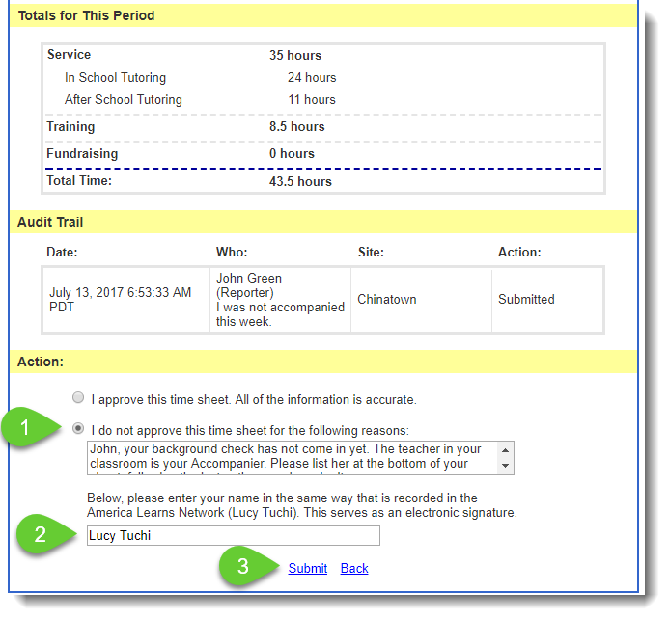
APPROVE/REJECT SHEETS
Member-by-Member
To Reject it:
1) Click the Do Not Approve button and enter a detailed reason, which the member will use to correct any mistakes.
2) Sign the sheet.
3) Click Submit.
4) An email will be sent to the Member notifying them that they need to correct their sheet.

Slide 14
useful reports

Slide 15
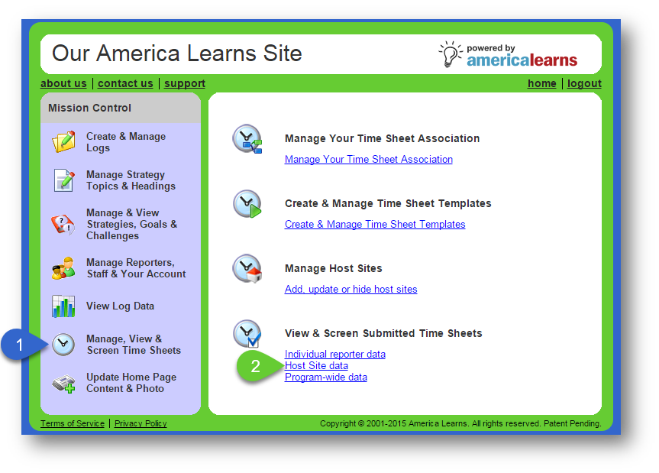
TRACK & REPORT
Finding Members Who Need to Submit Sheets
1) In your Mission Control, go to Manage, View & Screen Time Sheets.
2) Click Host Site data.

Slide 16
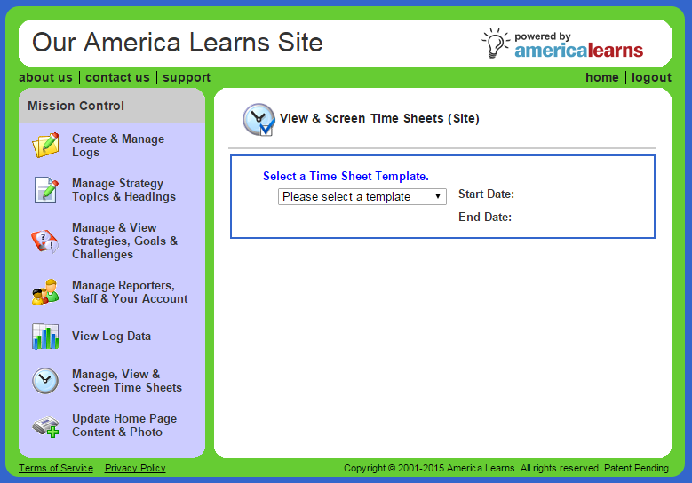
TRACK & REPORT
Finding Members Who Need to Submit Sheets
Choose your template from the drop-down menu.

Slide 17
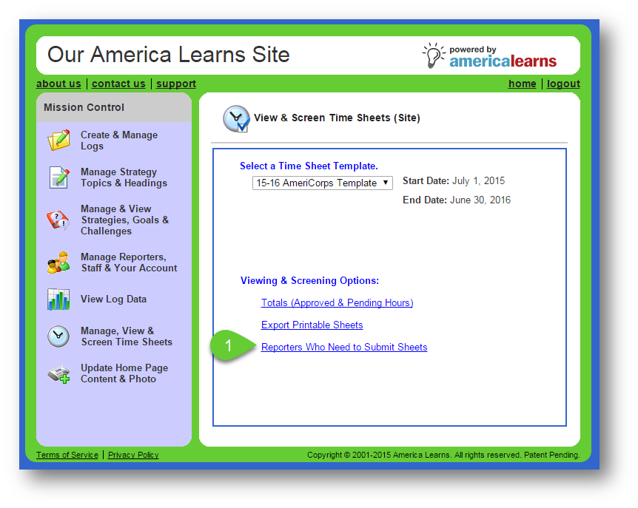
TRACK & REPORT
Finding Members Who Need to Submit Sheets
Click Members Who Need to Submit Sheets.

Slide 18
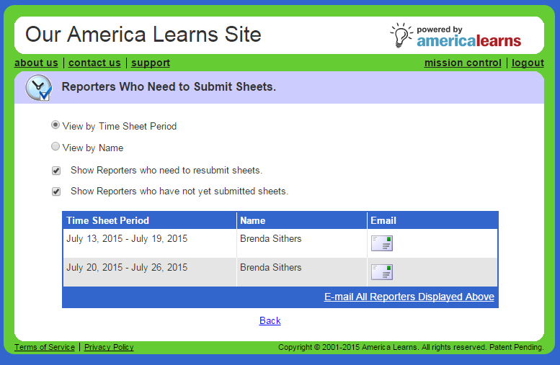
TRACK & REPORT
Finding Members Who Need to Submit Sheets
1) Choose how you would like to view the report and which Members you would like to include.
2) Use America Learns to email individuals by clicking the icon or click Email All Members Displayed Above to communicate with a group.

Slide 19
ALERTS AND REMINDERS
TIME SHEET AVAILABLE TO SCREEN
You’ll get an email from the system whenever your Member(s) submits a new time sheet for your review.
TIME SHEET IS RESUBMITTED
You’ll get an email from the system whenever your Member(s) resubmit a sheet you or another member of your team has rejected.
LATE TIME SHEETS
You’ll get an email/text when sheets are overdue for screening.
OTHER COMMUNICATIONS
Our team will use America Learns to blast out other important communications via email/text.

Slide 20
DESIGNED TO BE CONVENIENT
COMPUTERS
ANYWHERE THERE’S AN INTERNET CONNECTION
SMART PHONES
TABLETS
EASY TO USE ANYWHERE

Slide 21
getting support

Slide 22
WHERE TO TURN FOR HELP
WE ARE HERE FOR YOU
Need Help?
c
NAME: Caitlin Szabo | Holly Dennis
EMAIL: cszabo@hhck.org | hdennis@hhck.org
PHONE: 502.223.1834 ext. 103

