Slide 1
America Learns
TIMESHEET REVIEW - VISTA

Slide 2
Agenda
Purpose
Using it
Questions

Slide 4
Log in
www.americalearns.net/homesforall

Slide 5
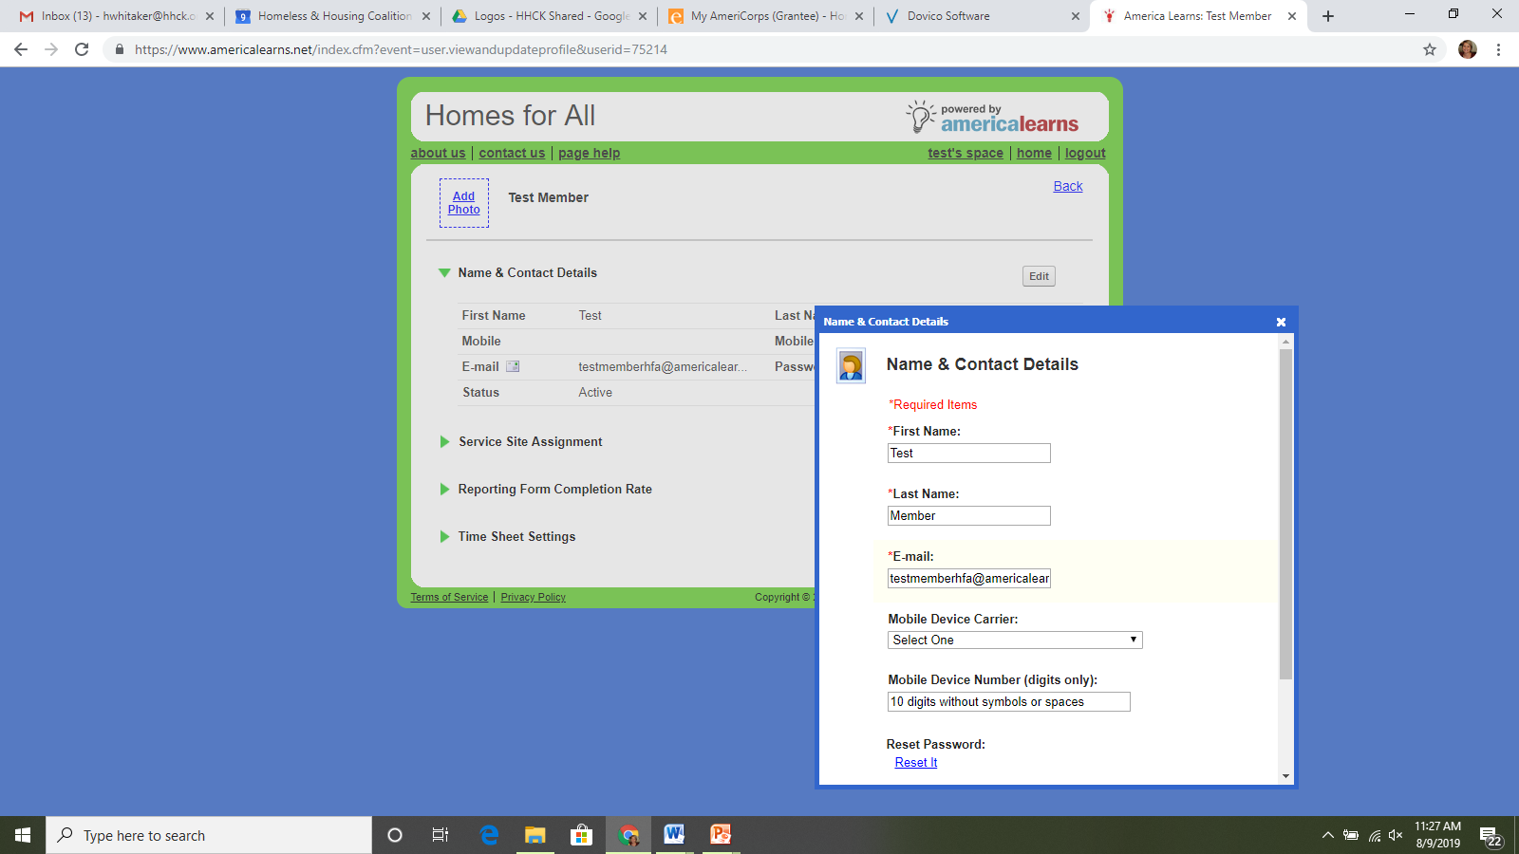
Access Your Profile
On the left, click View and Update Profile.
Here you can:
Update email + password

Slide 6
time sheets

Slide 7
Timesheet Dashboard
Where you are
Time sheet period
Where you are table
-This table will help you stay on-top of your service term by showing you:
Average Hours Needed Each Week to Successfully Complete your Program
Approved Hours
Pending Hours (hour not yet reviewed and accepted by supervisors/staff)

Slide 8
Timesheet Dashboard (cont.)
Viewing and opening time sheets
4. View Submitted Sheets -Here you can view any previously submitted time sheets by selecting the time sheet period you wish to view from the drop down menu.
5. Submit Time Sheets
-Here you’ll find any new and continued time. Click on the time period of the time sheet to open it.
6. Edit + Resubmit Time
-Any time sheets that have been returned for editing will appear under the section. Click on the time sheet to open it, make any edits, and re-submit.

Slide 9
Completing Your Time Sheet
Select the time sheet you’d like to work on
To get started, simply click on the link for the time sheet you would like to work on

Slide 10
Completing Your Time Sheet (cont.)
Selecting your site (where you serve)
1) First, select your site or sites by moving them from the Available to the Selected column.
2) Next, update your time sheet. There are two ways to do this:
Update Each Day Individually
Update & Apply to All Days

Slide 11
Completing Your Time Sheet (cont.)
“I did not serve.”
For each day of the time sheet period, you’ll need to note whether or not you served . If you didn’t serve, click the “I did not serve” checkbox.
Select the reason for not serving in the drop down menu.
If the reason isn’t listed, let us know before you submit your sheet, we’ll add it.

Slide 12
Completing Your Time Sheet (cont.)
Time in and time out
For each day of the time sheet period, you’ll need to use the time in and time out drop down boxes to select the time you arrived and left your site.

Slide 13
When to Use Them
Category
When to use it.
VISTA Service
You will use this most often – any service activity related to your site and VAD will be logged as service hours.
Homes for All: Any time you are doing something with Homes for All, KCCVS, or CNCS.
Examples – this training, AmeriCorps Launch, MLK Day, Spring Service Project, etc.
Site Specific: Any time your site offers a training opportunity.
Example: Grant writing workshop
Training

Slide 14
Completing Your Time Sheet (cont.)
Hours you won’t receive credit for
After you’ve allocated all the time you spent serving, you’ll need to account for any time leftover (i.e. lunch, break, doctor’s appointment, etc.). You’ll see this time listed under the Hours you won’t receive credit for section at the bottom of each day.

Slide 15
Hours Not Receiving Credit For
Program Policy
Break
Mid-morning coffee run? Smoke break? Categorize them here.
Lunch
Reminder – your lunch [half] hour does not count as time served.

Slide 16
Completing Your Time Sheet
Saving your work (copy + paste)
This save links shows up after each day.
Option 1: Save and continue completing your time sheet now. (Note: It’s not required to click “Save” for each day.”
Option 2: Save and continue completing your sheet later.
-----------------------------------
Once clicked, a window will open allowing you to choose the day or days you would like to past the current information to, and click Save & Apply.

Slide 17
Submitting Your Time Sheet (cont.)
Totals for the period
Totals for the Period, at the bottom of the sheet, summarizes all of your hours. Review it to make sure you’ve recorded everything.

Slide 18
Submitting Your Time Sheet (cont.)
Submit your time sheet
After you’ve reviewed your time, sign your sheet at the bottom and click Authorize and Submit to Your Supervisor for Approval.

Slide 19
Need Help?
EMAIL: hwhitaker@hhck.org
PHONE: 502.223.1834 ext. 103

