Slide 1
Motivational Interviewing
Kim Hollingsworth
Senior Housing Specialist
Homeless and Housing Coalition of Kentucky

Slide 2
What is Motivational Interviewing?
A therapy technique/conversational style that helps people resolve ambivalent feelings and insecurities to find the internal motivation they need to change their behavior
Practical
Empathetic
Short term (1-3 sessions)
Encourages clients to talk about their need for change and their own reasons for wanting to change
The role of the interviewer is to evoke a conversation about change and commitment

Slide 3
What is Motivational Interviewing?
MI is built on the premise that the clinician is not there to force clients to change but instead should facilitate the capacity clients already have within themselves to change. Although now used in fields as diverse as health care, education, and criminal justice, MI's roots are in addiction, and clinicians working with substance abusers from all walks of life are increasingly using the approach

Slide 4
When should I use
Motivational Interviewing?
Good for clients who are unmotivated or unprepared for change
Can be used with any goal
Addiction and managing physical symptoms (diabetes, heart disease)
Can help prepare people for other more specific types of therapies
Appropriate for people who are angry or hostile
Allows them to move through the emotional stages of change necessary to find their motivation
***Motivational Interviewing doesn’t work is all scenarios. For example, it isn’t helpful if a client is already motivated to change and can in fact cause a client who is motivated to regress because of taking them back through the steps.***

Slide 5
How does it work?
Evolved from Carl Rogers, person-centered, client-centered
William R. Miller, 1980’s
Two fold process
Increase the person’s motivation
Person to make the commitment to change

Slide 7
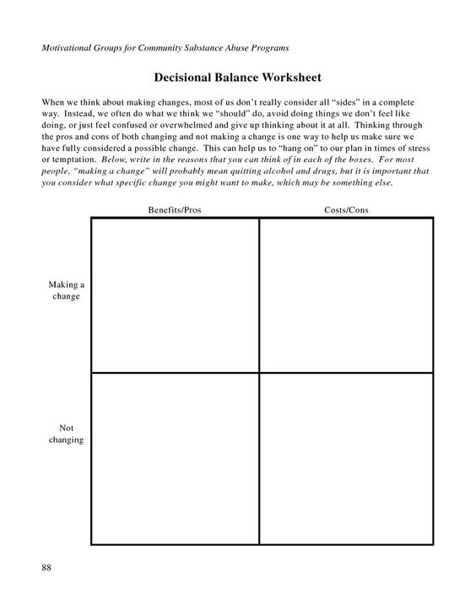

Slide 8
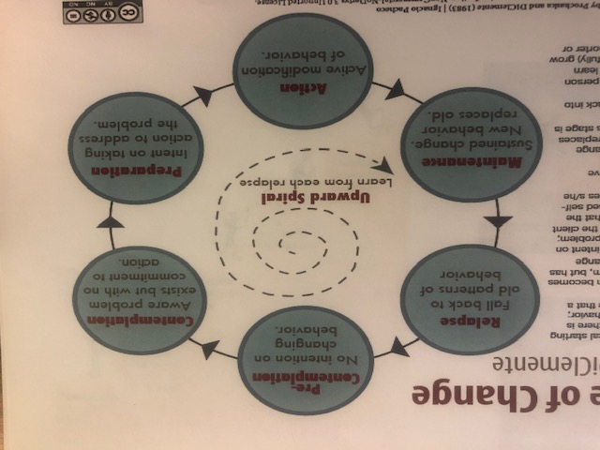

Slide 9
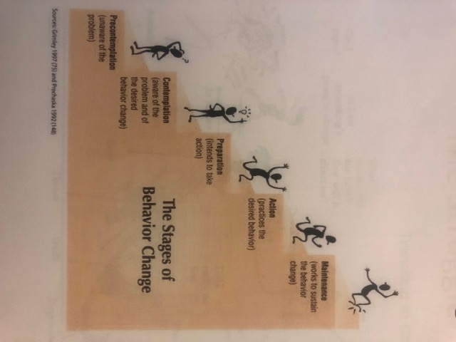

Slide 10
Precontemplation
Usually have no intention of changing
Typically deny having a problem
Usually show up in coaching because people around them want them to change
Feel demoralized, that their situation is hopeless

Slide 11
Contemplation
Acknowledge the problem and begin to think about what to do
Struggle to understand the problem, its causes, potential solutions
Not quite ready to change
May spend a while in this stage

Slide 12
Preparation
Planning to take action in the next month
Making final adjustments before they begin to change behavior
May not have resolved their ambivalence
Important to develop a firm, detailed action plan

Slide 13
Action
Overtly modify behaviors and surroundings
Modifying behavior is most visible form of change, but there is also changing level of awareness, emotions, thinking, etc.

Slide 14
Maintenance
Work here is to consolidate the gains made and prevent lapses and relapse
Can last from six months to a lifetime

Slide 15
Termination
Behavior no longer presents temptation
Complete confidence there won’t be a relapse

Slide 16
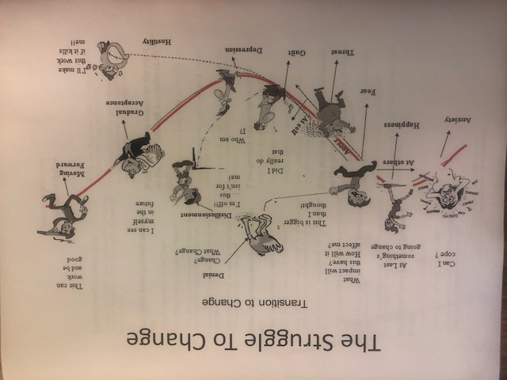

Slide 17
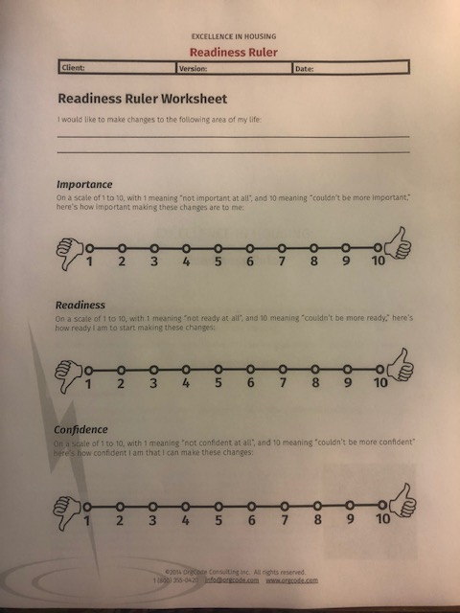

Slide 18
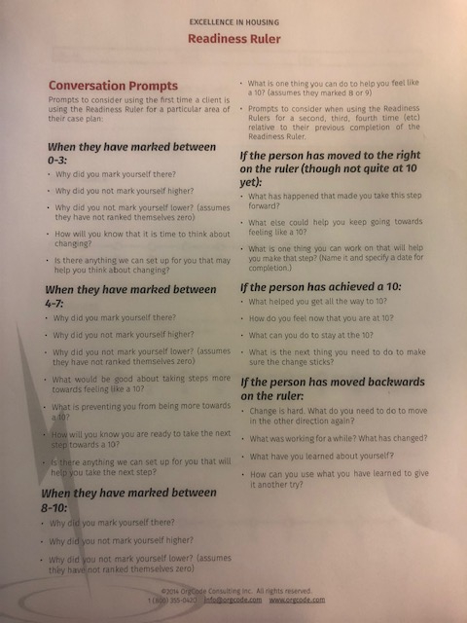

Slide 19
What Motivational Interviewing is NOT...
Motivational speaking. Not your time for a TED talk. :-)
Confrontational.
Time to preach.
How to avoid this? Stick to facts not opinions. Gentle confrontation with facts.

Slide 20
MI: Good Example

Slide 21
MI: Bad Example

Slide 22
Resources & References
https://www.psychologytoday.com/us/therapy-types/motivational-interviewing
https://www.socialworktoday.com/archive/111715p22.shtml
https://www.orgcode.com/products

