Slide 1

An Overview of Housing and Homelessness

Slide 2
Who Am I?
The Homeless and Housing Coalition of Kentucky is a statewide advocacy group dedicated to eliminating the threat of homelessness and fulfilling the promise of affordable housing. In addition to operating AmeriCorps and VISTA programs in partnership with communities, we advocate for nonpartisan housing policies on behalf of low-income Kentuckians, and provide permanent supportive housing to chronically homeless households. We are a 501(c)3 nonprofit founded in 1987.

Slide 3
What Is Affordable Housing?
A home that costs only 30% of monthly Adjusted Gross Income, including utilities
Source: HUD, https://www.huduser.gov/portal/glossary/glossary_a.html

Slide 4
Affordable Housing: A Nationwide Problem
“The federal government never developed a national plan to coordinate the construction of affordable housing where it was needed or required any city to construct it, and it never successfully challenged the notion that housing was a commodity, not a right.”
– Bryce Covert, The Nation
Source: https://www.thenation.com/article/give-us-shelter/
“Home prices are rising in almost the same pattern they displayed leading into the 2008 crash, and the goal of federal policy remains to get as much mortgage debt into the system as possible. It is a recipe for disaster.”
– Norbert Michel, Heritage Foundation
Source: https://www.heritage.org/housing/commentary/housing-finance-reform-has-never-really-been-about-affordable-housing

Slide 5

Affordable Housing: A Nationwide Perspective
Roughly 64% of Americans are homeowners
Roughly 35% of Americans are renters
38 million households spent more than 30% on housing in 2016
(Source: Joint Center for Housing Studies at Harvard University, 2018)

Slide 6

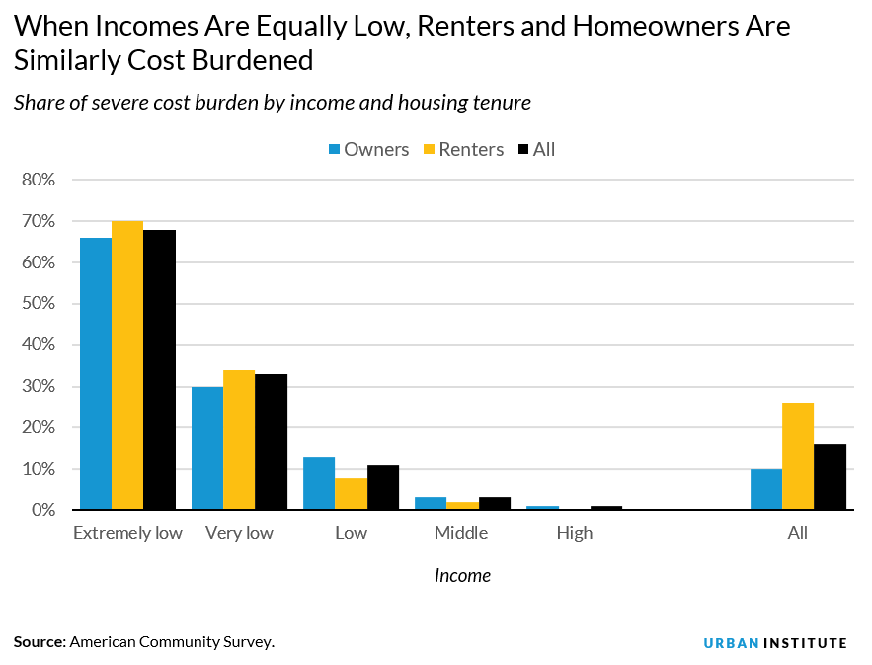
Who is More Cost-Burdened?
When controlling for income, a similar proportion of low-income homeowners and renters are severely cost burdened. Extremely low–income and very low–income homeowners are just as vulnerable to severe housing cost burdens as renters at the same income level.
In the extremely low–AMI group, 66 percent of homeowners and 70 percent of renters are severely cost burdened. And in the very low–AMI group, 30 percent of homeowners and 34 percent of renters are severely cost burdened. Although renters may face greater instability than homeowners, housing presents both groups with difficulties in meeting nonhousing needs.
- Laurie Goodman and Bhargavi Ganesh, Urban Institute
Source: https://www.urban.org/urban-wire/low-income-homeowners-are-burdened-housing-costs-renters

Slide 7
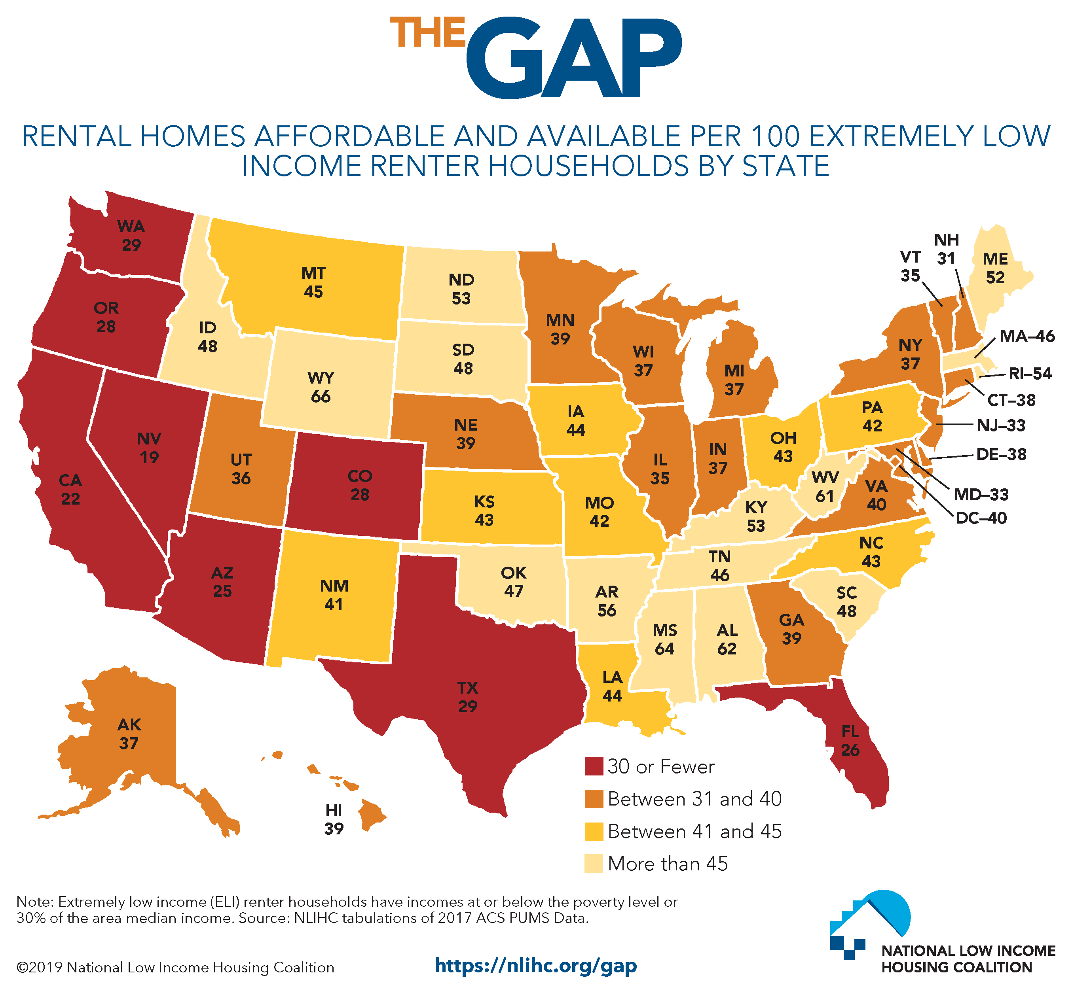
Extremely Low Income Renters
Put another way:
In KY, renters need to earn $14.40/hour FT to afford a 2 BR
If they are working at minimum wage, they would need to work 63 hours per week

Slide 8
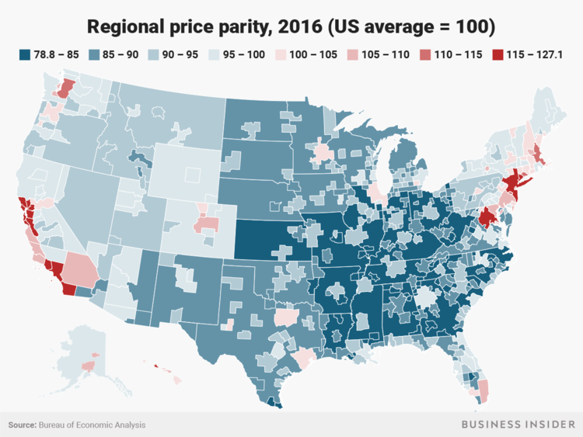
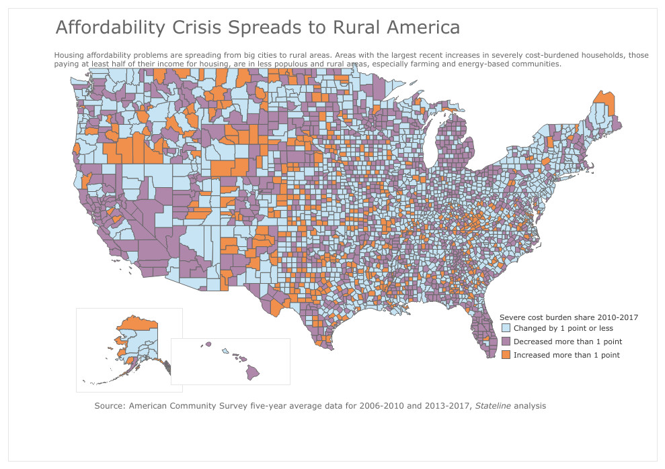
Is the Affordable Housing Crisis
Urban or Rural?

Slide 9
Homelessness
“On a single night in 2018, roughly 553,000 people were experiencing homelessness in the United States. About two-thirds (65%) were staying in sheltered locations—emergency shelters or transitional housing programs—and about one-third (35%) were in unsheltered locations such as on the street, in abandoned buildings, or in other places not suitable for human habitation.”
Source: HUD, Annual Homeless Assessment Report, 2018 (https://files.hudexchange.info/resources/documents/2018-AHAR-Part-1.pdf)

Slide 10

How Did We Get Here?
US Housing Act of 1937
Civil Rights Act of 1964
Creation of HUD in 1965
Fair Housing Act of 1968
Housing and Community Development Act of 1974
McKinney-Vento Homeless Assistance Act of 1987
Cranston-Gonzalez National Affordable Housing Act
HUD Rulemaking: program regulations, Affirmatively Furthering Fair Housing, various proposed rules under consideration

Slide 11
And then….
The Great Recession

Slide 12

Housing Tax Expenditures
“Federally backing $700,000 and $450,000 home loans simply does not help low-income homebuyers.
More broadly, federally backing these loans does not make housing more affordable. If home prices in any given area rise to two and three times the typical U.S. home price, federal policies that make it easier to borrow these larger sums put more upward pressure on these home prices.”
– Norbert Michel, Heritage Foundation
Mortgage Interest Deduction
$71B in 2015
Source: Matthew Desmond, New York Times https://www.nytimes.com/2017/05/09/magazine/how-homeownership-became-the-engine-of-american-inequality.html?action=click&pgtype=Homepage&region=CColumn&module=MostViewed&version=Full&src=mv&WT.nav=MostViewed&_r=0

Slide 13
Affordable Housing Tax Expenditures
Low-Income Housing Tax Credit
Cost: $9 billion annually
Built about 2 million units
Credits are awarded through state housing finance agencies
Source: Tax Policy Center, https://www.taxpolicycenter.org/briefing-book/what-low-income-housing-tax-credit-and-how-does-it-work

Slide 14
Selected Existing Major Federal Programs
(source: https://nlihc.org/sites/default/files/NLIHC_HUD-USDA_Budget-Chart.pdf)
HUD Programs | FY19 Final | FY20 Administration Proposal | FY20 House T-HUD Proposal
CDBG | 3.365 | 0 | 3.6
HOME | 1.250 | 0 | 1.750
Homeless Assistance Grants | 2.636 | 2.599 | 2.800
HOPWA | 393M | 330M | 410M
Housing Choice Vouchers | 22.598 | 22.244 | 23.810
Project-Based Section 8 | 11.747 | 12.021 | 12.590
National Housing Trust Fund | 245M | 0 | Unknown
Public Housing Operating | 4.65 | 2.86 | 4.753
Section 202 (Elderly) | 678M | 644M | 803M
Section 811 (Disabilities | 184M | 157M | 259M

Slide 15
Existing Major Federal Programs (cont’d)
USDA Rural Housing Service
“Like the Administration's FY19 budget, this year's proposal would zero out funding for all rural housing programs except Section 502 guarantees, Section 538 guarantees for rental housing production, and renewals of existing Section 521 Rental Assistance and Section 542 vouchers.” – Housing Assistance Council (source: http://www.ruralhome.org/whats-new/menu-policy/1711-administration-again-proposes-eliminating-many-housing-programs)
Department of Energy – Weatherization/LIHEAP
“The Trump administration is even proposing to fully eliminate the Weatherization Assistance Program that helps low-income families lower their bills and make their homes more comfortable.” – Natural Resources Defense Council (source: https://www.nrdc.org/experts/lauren-urbanek/proposal-cut-efficiency-budgets-makes-no-sense)
Federal Housing Finance Administration – Fannie Mae, Freddie Mac

Slide 16
Current Challenges
Only 1 in 4 families eligible for public housing actually receives it
Evictions
Ability to Use Vouchers
Budget Control Act/Sequestration
Concentration of poverty and segregated housing in developing new units/preserving aging units
Aging housing stock
Unsheltered homelessness is trending upward
Regulatory barriers to creating new housing

Slide 17
The Need for Affordable Housing in Kentucky
Kentucky has a shortage of safe, decent, and affordable housing options for low- and moderate-income households, which include service sector and public sector employees, such as municipal government employees.
There are three broad categories of housing, regardless of income level: owner-occupied (typically single-family homeownership); rental units; and manufactured housing (which can be either owner- or renter-occupied).
Of these types, owner-occupied represents 68.4%, renter-occupied represents 31.6%, for a total of 1,694,996 occupied units in 2013. The rate has fluctuated somewhat from year to year, ranging from 65-75% since 1986, and hitting 70.1% in 2017. Of these units, 12.3% are manufactured housing
The ratio between owner- and renter-occupied is commensurate with the national average, while the percentage of manufactured units is much higher – nearly double the national average.
Like the rest of the nation, Kentucky experiences a housing affordability problem, which has been mitigated to some extent by federal and some local housing assistance.
Source: https://www.hhck.org/research-and-resources

Slide 18
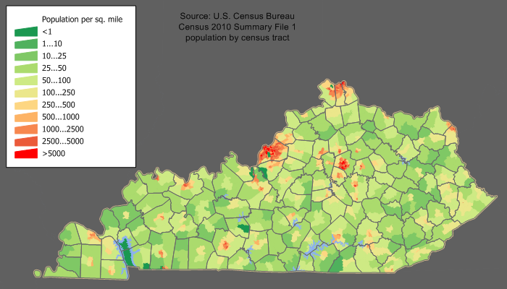
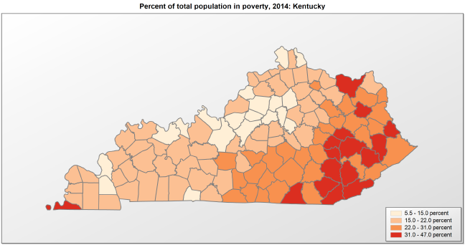
Selected Demographics for Kentucky

Slide 19
Environmental Factors
Poverty
It has been well-documented that Kentucky is a poor state; 18.5% of the population currently lives in poverty according to the U.S. Census (n.d.), which places Kentucky in the highest quintile of states using this comparison. The average figure for the United States is 12.7% (U. S. Census Bureau, n.d.). Looking at annual median household income, Kentucky reports $44,811 as compared to the US, at $55,322 (U. S. Census Bureau, n.d.). There are deep pockets of persistent poverty and significantly lower incomes deviating from the state median, particularly in Eastern Kentucky, many of which the Appalachian Regional Commission has consistently designated as economically distressed for over forty years.

Slide 20
Environmental Factors
Wage Stagnation
Since the official resolution of the Great Recession in 2012, Kentucky wages have remained stagnant. According to Spalding (2018), wages in terms of real dollars have less purchasing power than they did in 2007, before the recession. Labor force participation is materially lower (59%) than the national average (63.1%) (U. S. Census Bureau, n.d.). The combination of lower incomes and actual earned wages make housing less affordable to households, regardless of housing costs.

Slide 21
Environmental Factors
Housing Stock Characteristics
Overall, the median value of Kentucky’s housing units is lower ($126,100) than the country’s ($184,700). The median age of housing (34 years) has increased since 2000 (when it was 27 years), since new construction has not replaced older units at the same pace (Kentucky Housing Corporation, 2015), which may indicate that the housing stock available is less energy efficient and habitable than newer units would be. The Housing Assistance Council (n.d.) reports that 28.4% of units are “inadequate housing,” which may be a combination of incomplete plumbing, kitchen facilities, overcrowding, or cost burden. Of the federally assisted rental units requiring Housing Quality Standards, 20% fail upon initial inspection and require correction (Kentucky Housing Corporation, 2015).

Slide 22
Rental Need in Kentucky
Source: https://nlihc.org/housing-needs-by-state/kentucky
157,889% OR 28%
Renter households that are extremely low income (ELI)
$25,100
Maximum income for 4-person ELI household (state level)
-74,940
Shortage of rental homes affordable and available for ELI renters
$31,183
Annual household income needed to afford a two-bedroom rental home at HUD's Fair Market Rent.
66%
Percent of ELI renter households with severe cost burden/spending >50% of income on housing
84%
Percent of ELI renter households with cost burden/spending >30% of income on housing

Slide 23
Homelessness in Kentucky
In Kentucky, 4079 people were homeless on the last Wednesday in January 2019. Of that number, half were in the non-metro areas.
Source: Kentucky Housing Corporation K-Count Results and HHCK’s analysis (https://www.hhck.org/research-and-resources)

Slide 24
A Word about the Point in Time Count
The Point-in-Time (PIT) count is a count of sheltered and unsheltered homeless persons on a single night in January. HUD requires that Continuums of Care conduct an annual count of homeless persons who are sheltered in emergency shelter, transitional housing, and Safe Havens on a single night. Continuums of Care also must conduct a count of unsheltered homeless persons every other year (odd numbered years).
Each count is planned, coordinated, and carried out locally. The Housing Inventory Count (HIC) is a point-in-time inventory of provider programs within a Continuum of Care that provide beds and units dedicated to serve persons who are homeless, categorized by five Program Types: Emergency Shelter; Transitional Housing; Rapid Re-housing; Safe Haven; and Permanent Supportive Housing.
Source: www.hudexchange.info
  Balance of State CoC: K-Count
  Lexington CoC: LexCount
  Louisville CoC: Street Count

Slide 25
Coordinated Entry/Common Assessment
When someone who is homeless contacts you:
Lexington: dial 211 or http://www.uwbg211.org/
Louisville: 502-637-2337
Everywhere else: it’s complicated

Slide 26
In the 118 counties excluding
Fayette and Jefferson…

Slide 27
Overall Housing Need in Kentucky
Type of Housing Need | Percentage based on each type of housing | Number based on each type of housing
Homeownership cost-burden (household) (Housing Assistance Council, n.d.) | 21.4% | 228,266 households
Rental cost-burden (household) (Housing Assistance Council, n.d.) | 48.6% | 245,912 households
Total households in need of affordable homes (U.S. Census, 2017) | 28% of Kentucky households are cost-burdened, based on an estimate of 1,718,217 households | 474,178 households or 1,180,703 individuals (at 2.49 average household size)
Total literally homeless (Kentucky Housing Corporation, 2018) (U.S. Census, 2017) | 0.082% based on population estimate of 4,454,189 | 3,688 individuals
Total individuals in need of affordable homes | 26.6% based on population estimate of 4,454,189 | 1,184,391
BOTTOM LINE:
ABOUT 1 IN 4 KENTUCKIANS ARE HOUSING-INSECURE.

Slide 28


Housing in the Time of Corona

Slide 29
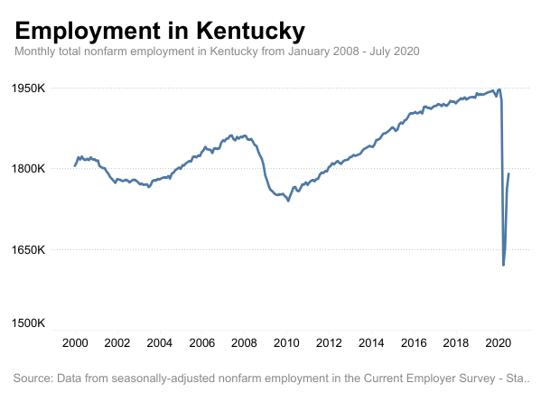
Housing in the Time of Corona
About 30-40M Americans at risk of eviction
Who will get hurt? Everyone.
https://www.washingtonpost.com/business/why-a-historic-eviction-wave-is-bearing-down-on-the-us/2020/08/26/123a9ffa-e759-11ea-bf44-0d31c85838a5_story.html
Notes:
Studies show that evictions affect Black and Latinx renters at much higher rates than White people. Renters with children are also more likely to be forced out of their home than those without. Getting evicted can make it harder for people to find a new place to live, because landlords often don’t want to rent to them. Smaller property owners with fewer financial resources may get squeezed, too, if they can’t collect enough rent to cover mortgages, property taxes and maintenance. A wave of foreclosures on these properties could gut the nation’s affordable housing stock, hurt city budgets and put strain on the banking system.

Slide 30
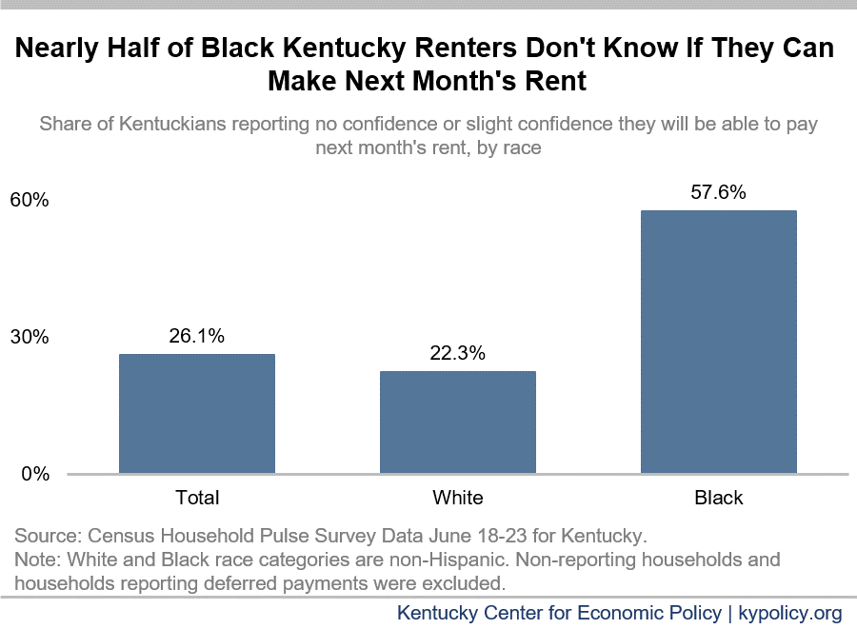
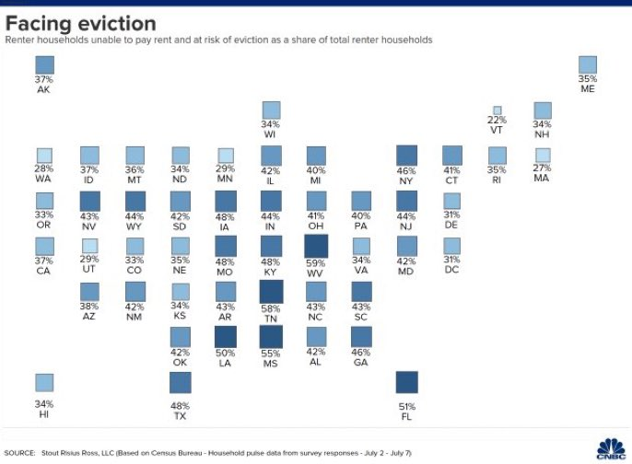
Nearly half of KY renters at risk of eviction
July August

Slide 31
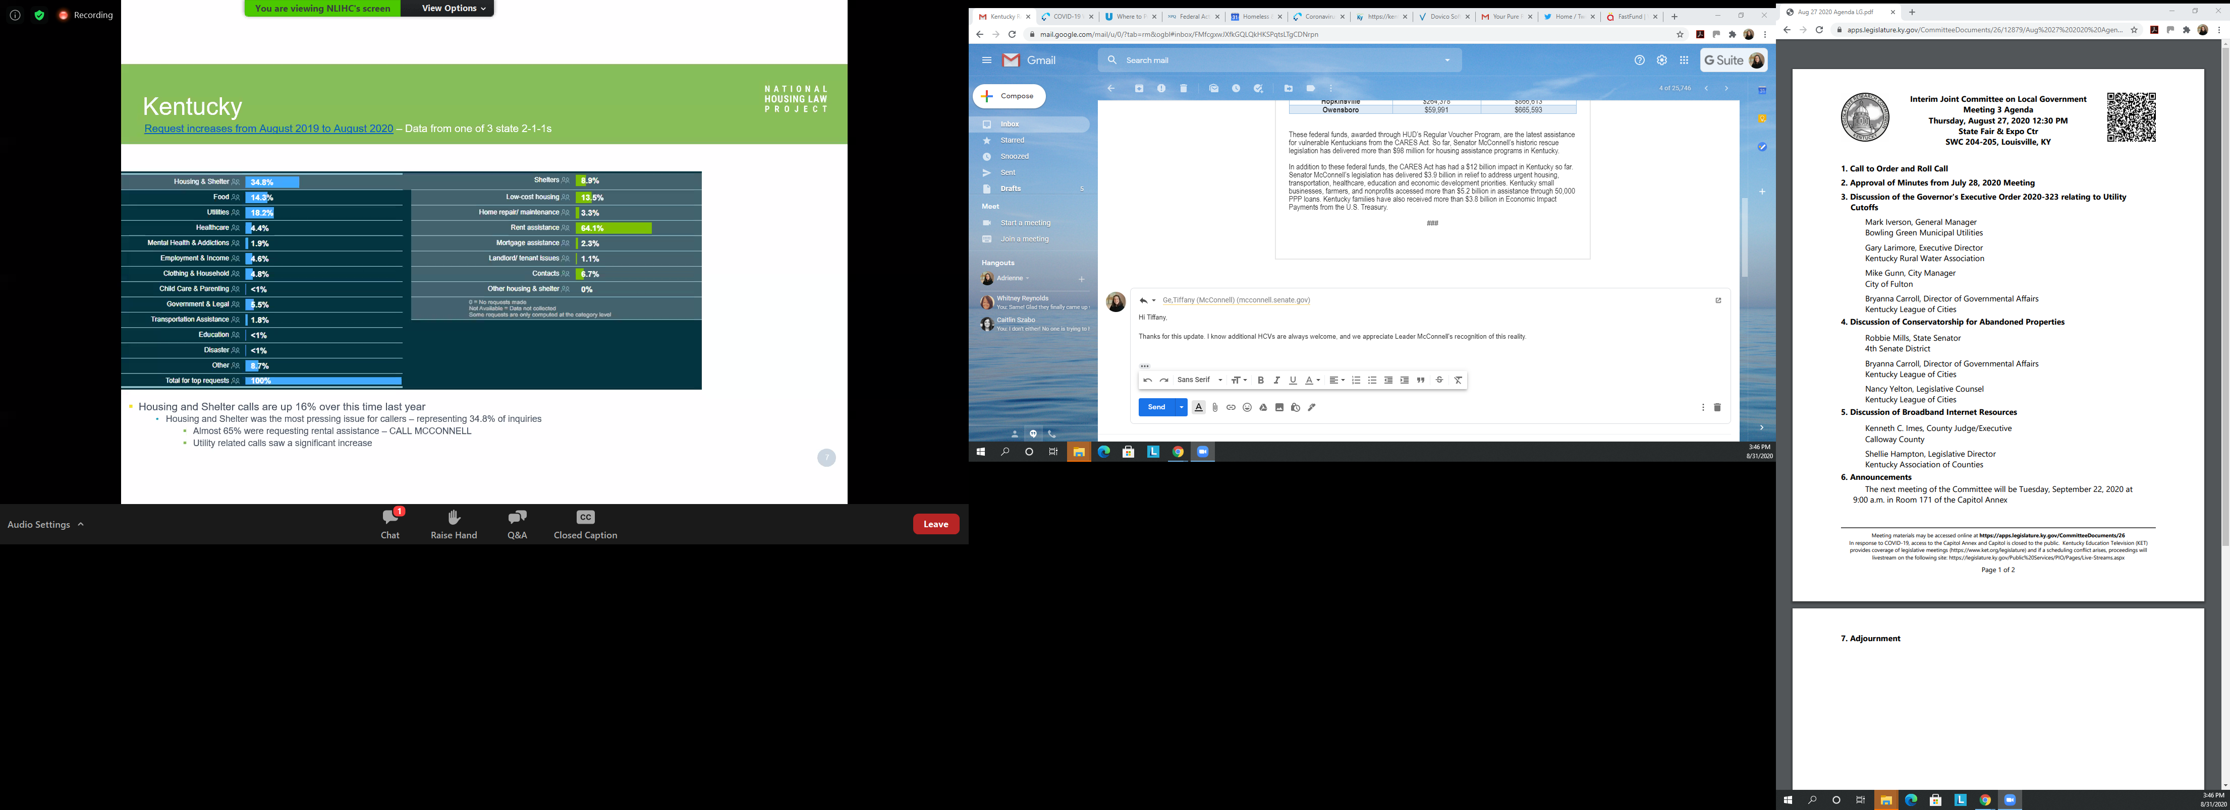
Nearly half of KY renters at risk of eviction
Of all 211 calls in Louisville Metro:
Largest share (35%) is for housing and shelter
Of housing and shelter calls: 64% is for rent assistance

Slide 32
Federal Assistance Overview
Statewide*
Eviction Prevention: $15M in CARES Act state funding, designated by Gov. Beshear
Application portal to open on 9/9
Lexington
Housing Relief: <$1.5M in Emergency Solutions Grant and Community Development Block Grant funds
Visit: https://covid19renterhelp.org/
Notes:
Issue of capacity at shelters

Slide 33
Federal Assistance Overview
Louisville
$21M in rental assistance was designated in July
Application portal: https://www.stopmyeviction.org/
The other 118 counties
Rapid Re-Housing for literally homeless: a very rough estimate of $10M CARES Act Emergency Solution Grant to be allocated regionally
Operations funding for shelters now open: http://www.kyhousing.org/Specialized-Housing/Pages/Emergency-Solutions-Grant.aspx
Notes:
Issue of capacity at shelters

Slide 34

Legal Resources
Are you —
• a Kentuckian who rents your home?
• an attorney helping Kentuckians facing eviction?
• anyone who wants Kentucky renters to have more rights?
This tool is for you: kyrenterhelp.org
Notes:
Issue of capacity at shelters

Slide 35
Contact Information
Adrienne Bush, Executive Director
Homeless and Housing Coalition of Kentucky
502-223-1834, ext. 101
306 W. Main St., Frankfort, KY 40601
www.hhck.org
FB/Twitter: @HHCKy

