Slide 1
How a coordinated entry system works and the implementation of a housing first approach to ending homelessness
By Cassie Carter, MSSW, CSW
HHCK, Housing Program Manager

Slide 2
ABOUT ME
I grew up in Southern Indiana, 20 minutes North of Louisville
Graduated from Asbury University in May 2016 with my BASW
Graduated from U of L, Kent School of Social Work with my MSSW in May 2017
Married on May 26, 2018
Living in Lexington, KY with my husband, two pugs, cats, and soon to be baby girl
Housing Stabilization Specialist at HHCK from August 2017 to January 2019
Housing Program Manager at HHCK since January 2019

Slide 4
Today we will be discussing
Housing First
Coordinated Entry System
Any door KY

Slide 5
History of Ending Homelessness
First Come, First Serve
Waiting Lists
Lack of evidence-based practice
Housing Ready
Inconsistent Intake/Application
Program Centered
High barrier

Slide 6
HOUSING READINESS
Prior to Housing First, housing providers primarily used a housing ready approach to ending homelessness in which an individual must prove they are “ready” for housing prior to receiving assistance.
For example: Someone with a substance use disorder must complete a treatment program and pass “X” amount of drugs tests prior to receiving assistance.
Barriers: such as someone’s housing and criminal history prevented them from receiving housing assistance (although often still a barrier today)
Limitations: ex: attending skills classes (parenting, finances, religious classes)
These cause delays to being housed and prolong one’s experience of homelessness.
They have proven to be ineffective in ending homelessness

Slide 7
Housing First
Considers housing to be a basic human right
Answers the basic question of “how do we solve homelessness?”
Housing first does NOT mean that housing is the only need, but it must be the first stage of assisting someone with housing stability. A housing first approach still recognizes the need for supportive through progressive engagement.
Implements case management once housing is achieved to provide support and connect individuals and families to resources in their community based on their needs. Case management is not a requirement but is highly encouraged.
Houses people where they want to be housed

Slide 8
Housing First cont.
Practices harm reduction: A model of substance-use intervention that focuses on helping people who use substances to better manage their use and reduce the harmful consequences to themselves and others.
Client centered: Housing is available no matter what is going on in someone’s personal life. It if flexible and allows the client to decide where they want to be housed. The client is the expert on their situation, their needs, and the goals they want to achieve.

Slide 9
Housing First: Principles Into Practice

Slide 10
In Comparison
Housing Ready
Housing First
High barrier
Program centered
Services first, then housing
No harm reduction
Prolongs homelessness
Housing is a privilege
Low barrier
Client centered
Housing first, then supportive services (case management, treatment, etc.)
Harm reduction implemented
Quickly and effectively ends homelessness
Housing is a right

Slide 11
Housing First, according to the U.S. Interagency Council on Homelessness
A housing first system recognizes that people experiencing homelessness need the safety and stability of a home in order to best address challenges and pursue opportunities.
It connects people as quickly as possible to a home and at the same time makes available the services that people may need to be stable and secure.

Slide 12
Housing First, according to the U.S. Interagency Council on Homelessness
6 Core Components
Street outreach providers, emergency shelters, and other parts of the crisis response system are working closely with housing providers to connect people to permanent housing as quickly as possible.
The community has a data-driven coordinated assessment system for matching people experiencing homelessness to the most appropriate housing and services based on their needs.
The community has a unified and streamlined process for applying for rapid re-housing, supportive housing, and/or other housing interventions.
Community leaders work collaboratively to ensure that a range of affordable and supportive housing options and models are available to meet local needs.
Policies and regulations related to supportive housing, social and health services, benefit and entitlement programs, and other essential services do not create needless barriers to housing.
Communities work to ensure that people are not evicted back into homelessness whenever possible.

Slide 13
Solution to Ending Homelessness

Slide 14
Coordinated Entry System and the Common Assessment

Slide 15
What is coordinated entry?
“A centralized or coordinated process designed to coordinate program participant intake, assessment, and provision of referrals across a geographic area. The system covers the geographic area (designated by the CoC), is easily accessed by individuals and families seeking housing or services, is well advertised, and includes a comprehensive and standardized assessment tool.” (24 CFR Section 578.7).
It is the responsibility of each CoC to implement Coordinated Entry in their geographic area.
The goal is to connect individuals and families experiencing homelessness to housing and supportive services as quickly as possible.

Slide 16
A coordinated entry system aims to:
Divert those who can solve their own homelessness away from entering the coordinated entry system
Move people from homelessness to permanent housing quickly and effectively
Create an effective role for emergency shelters and transitional housing
Use the correct housing intervention
Reduce length of time homeless
Increase housing stability
End homelessness across communities, not just within individual programs

Slide 17
What’s a CoC?
Continuum of Care (CoC) is a geographical area designated by each state to receive federal HUD funding
Kentucky has three CoC’s:
Balance of State CoC (118 counties across KY)
Lexington CoC (Fayette county)
Louisville CoC (Jefferson county)

Slide 18
How does the intake/assessment process work?
All agencies that receive Emergency Solutions Grant (ESG) or CoC funding from HUD or the Kentucky Housing Corporation (KHC) is an access point for the Coordinated Entry System.
This means that a person experiencing homelessness could go to any of those agencies to complete the common triage tool (VI-SPDAT)
The housing provider will then have the individual complete a Kentucky Homeless Management Information System (KYHMIS) Release of Information as consent to administer the VI-SPDAT.
VI-SPDAT’s can also be completed over the phone with the use of the verbal KYHMIS ROI

Slide 19
A VI what?
VI = Vulnerability Index by Community Solutions.
It was made popular during the 100,000 Homes Campaign that began in 2010, ended in 2014, and included 200 communities.
Administered as a Survey
SPDAT = Service Prioritization Decision Assistance Tool.
Developed by OrgCode Consulting, Inc.
In depth evaluation tool, takes 1 to 2 hours to complete
Good for ongoing case management to track client progress
Must be trained by OrgCode certified trainer to administer

Slide 20
VI-SPDAT
The combination of the VI and SPDAT began in 2013 through OrgCode’s collaboration with Community Solutions. They built it upon reviewing existing tools, interviews with direct service providers, an academic panel, and hundreds of published journal articles, reports, and tools.
Developed to quickly determine if an individual or family has high, moderate, or low acuity
Training can be completed online

Slide 21
VI-SPDAT
Vulnerability Index – Service Prioritization Decision Assistance Tool
An evidence based triage tool utilized by all housing providers in the Balance of State CoC to determine acuity for the purpose of housing triage, prioritization, and housing placement.
Three types
Single adult VI-SPDAT
Family VI-SPDAT
Youth TAY-VI-SPDAT (for individuals 24 and under)
Identifies a housing intervention recommendation based off an individual or families specific needs

Slide 22
Three possible recommendations
Permanent Supportive Housing (PSH)
Individuals: 8+
Families: 9+
Rapid Re-Housing (RRH)
Individuals: 4-7
Families: 4-8
No housing intervention/diversion
Individuals: 0-3
Families: 0-3

Slide 23
What happens after a VI-SPDAT is completed?
The client information and VI-SPDAT is entered into KYHMIS to be accessed by Local Prioritization Communities.
The VI-SPDAT scored will appear on each LPC’s prioritization list.
Each LPC lead agency is responsible for generating and managing the prioritization list for their LPC.
The LPC lead agency is also responsible for scheduling and maintaining monthly or bi-weekly LPC coordinated entry meetings.
During the coordinated entry meetings the prioritization list is used to refer individuals and families experiencing homelessness to available housing resources.

Slide 24
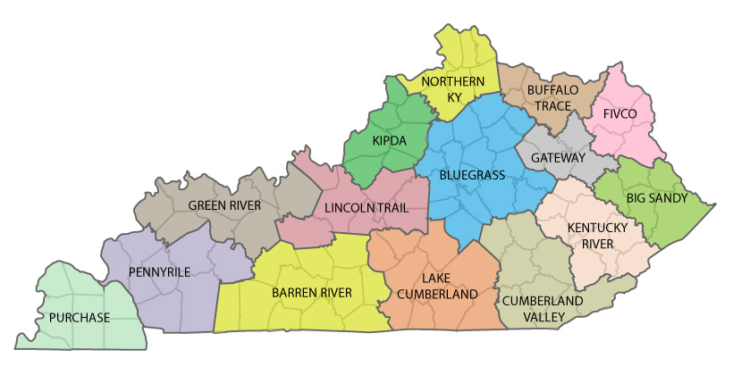

Slide 25
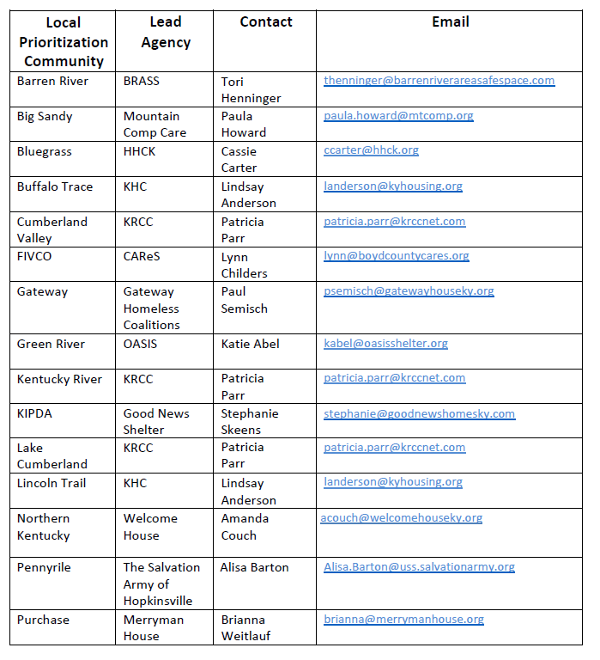

Slide 26
The referral process
The LPC begins the matching process during the LPC meeting.
Each agency in the LPC will first start by stating how many resources they have available at the time, meaning how many new referrals they can take.
The LPC lead then has the responsibility of matching available PSH and RRH resources to clients with the highest acuity, meaning the most severe needs.
If there are several individuals on the prioritization list who have the same acuity they are prioritized by how long they have been homeless.

Slide 27
Victim Service Provider (VSP) Referrals
Individuals and households fleeing domestic violence and residing at a DV shelter are entered into the coordinated entry system through a different process
The VSP will complete a paper form of the VI-SPDAT and put the necessary information on a VSP inclusion form.
The VSP inclusion form then gets emailed to the LPC Lead and that person manually adds them to the prioritization list
No names or identifying information (DOB, SS#) is used, instead the VSP gives the client a unique ID. These clients are not entered into HMIS.
Example: GH17 Outreach worker completes VI-SPDAT with person fleeing DV. Then they complete the Inclusion form and email it to me. I manually add it to the prioritization list. They are prioritized with everyone else on the list, but are often referred to a DV Housing Provider (KCADV)

Slide 28
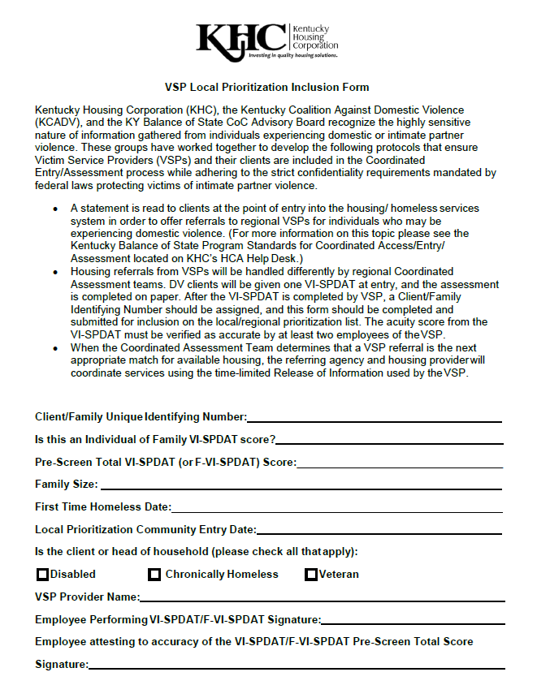

Slide 29
Prioritization
The matching/referral process is also known as prioritization.
Prioritization takes the place of “waiting list” and serves those with most severe needs first, like how an emergency room operates.
Order of priority is in the Coordinated Entry Policies and Procedures
Highest Acuity
If PSH (those who are chronically homeless and have a disability are referred first)
Longest time homeless

Slide 30
After referral
Once a referral has been made for an individual or family, the goal is to get them into permanent housing as quickly and effectively as possible
The agency that completed the initial VI-SPDAT is responsible for completing documentation and paperwork required by the housing provider.
Once all paperwork has been completed, the referring agency will send it all to the housing provider.
The housing provider takes over from there and works with the client to identify an available unit and get them leased up.
In the Bluegrass Add we have a Housing Navigator that is staffed by HHCK but available to assist any agency with their referrals housing search

Slide 32
Thanks for listening!
Contact Information:
Cassie Carter
Housing Program Manager
ccarter@hhck.org
502-223-1834 x106

