Slide 1
Event PLANNING 101
How to throw a unforgettable bash

Slide 2
Being an event planner is all about throwing the most awesome shindig ever, right? For sure. But the job involves way more than venue selection and decor decisions.

Slide 3
Event Planning 101
What does an event planner actually do?
It’s an event planner’s job to ensure everything related to an event is taken care of, from idea conception to programming and day-of logistics. An event planner is charged with creating experiences and bringing visions to life, which means stirring multiple pots.

Slide 4
1. Meeting with clients
2. Scouting locations
3. Soliciting bids
4. Managing vendor relationships and client communications
5. Establishing and negotiating contracts, and managing budgets are all part of the drill, as are setting and managing clients’, board members and vendors’ expectations. It’s not always for the faint of heart.

Slide 5
Are there other titles with similar responsibilities?
Directors of events, event producers and event managers may have similar responsibilities, though “planner” and “producer” imply creative direction while “manager” implies implementation. But it depends on the company. At smaller companies, one person, regardless of her title, typically handles the vision.

Slide 6
What do I need to get ahead in this position?
Be passionate about what you do.
Event planning is stressful—tons of people are relying on you to deliver the goods, figuratively and literally, on an important day.
Loving your job will help you give it everything you’ve got.
It also helps to master the art of multitasking and be proactive.

Slide 7
10 Steps to Get Started
Step 1 – Volunteer for caterers, florists, at nonprofits, or work for an established event planner. Your long-term success in event planning will be based on the experience that you bring to your clients. That means, if you’re thinking about getting started as an event planner, you should understand what an event planner does and what skills are needed.

Slide 8
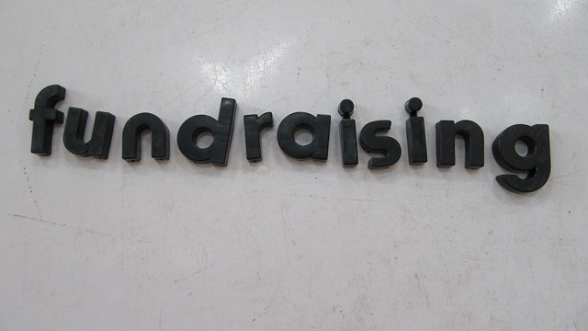
Step 2 – Take on more responsibility. Become a fundraising chair for your nonprofit

Slide 9
Questions to answer yourself to help determine your niche:
What event services will you offer?
Who do you like working with?
What type of budgets do you have?
Venue
Catering
Silent Auction

Slide 10
Step 3 – It’s not what you know, but who you know.
In event planning, networking is key so go to networking events, hand out business cards and let everyone know you’re an event planner! Wherever you go, hand out business cards and collect contact information for the people you meet.

Slide 11
Step 4 – Create an event portfolio
Take photos and save everything like brochures, and invitations of the events you’ve planned. Organize each piece online to easily present your experience and share your stories.

Slide 12
Step 5 – Take an event course.
Your success as an event planner is based on your event experience and knowledge. Taking a professional course helps you gain credibility, teaches you about industry trends, and helps you establish contacts within the industry.

Slide 13
Step 6 – Create a plan
Look at the past events your location hosted and ask questions?
What worked
What did not work
What silent auction items did they like/not like
Was the food ok?
Venue - was it too big/too small or perfect

Slide 14
Step 7 – Media
If you plan to advertise your event you need to contact the media early – the “feel Good” spots fill up fast.
You may also want to put in on the online community boards

Slide 15
Step 8 – Start a budget

Slide 16
Step 9 – Marketing
Create or update the website and social media accounts. Print invitations and posters.
Let people know about the event

Slide 17
Step 10 – Develop your network
Do you have donors who own businesses that you can use?
Get input on suppliers
Network, network, network!!!!!!

Slide 18
Yvette Davis
Development Coordinator
Lexington Rescue Mission
(859) 523-1660

